Slide 1
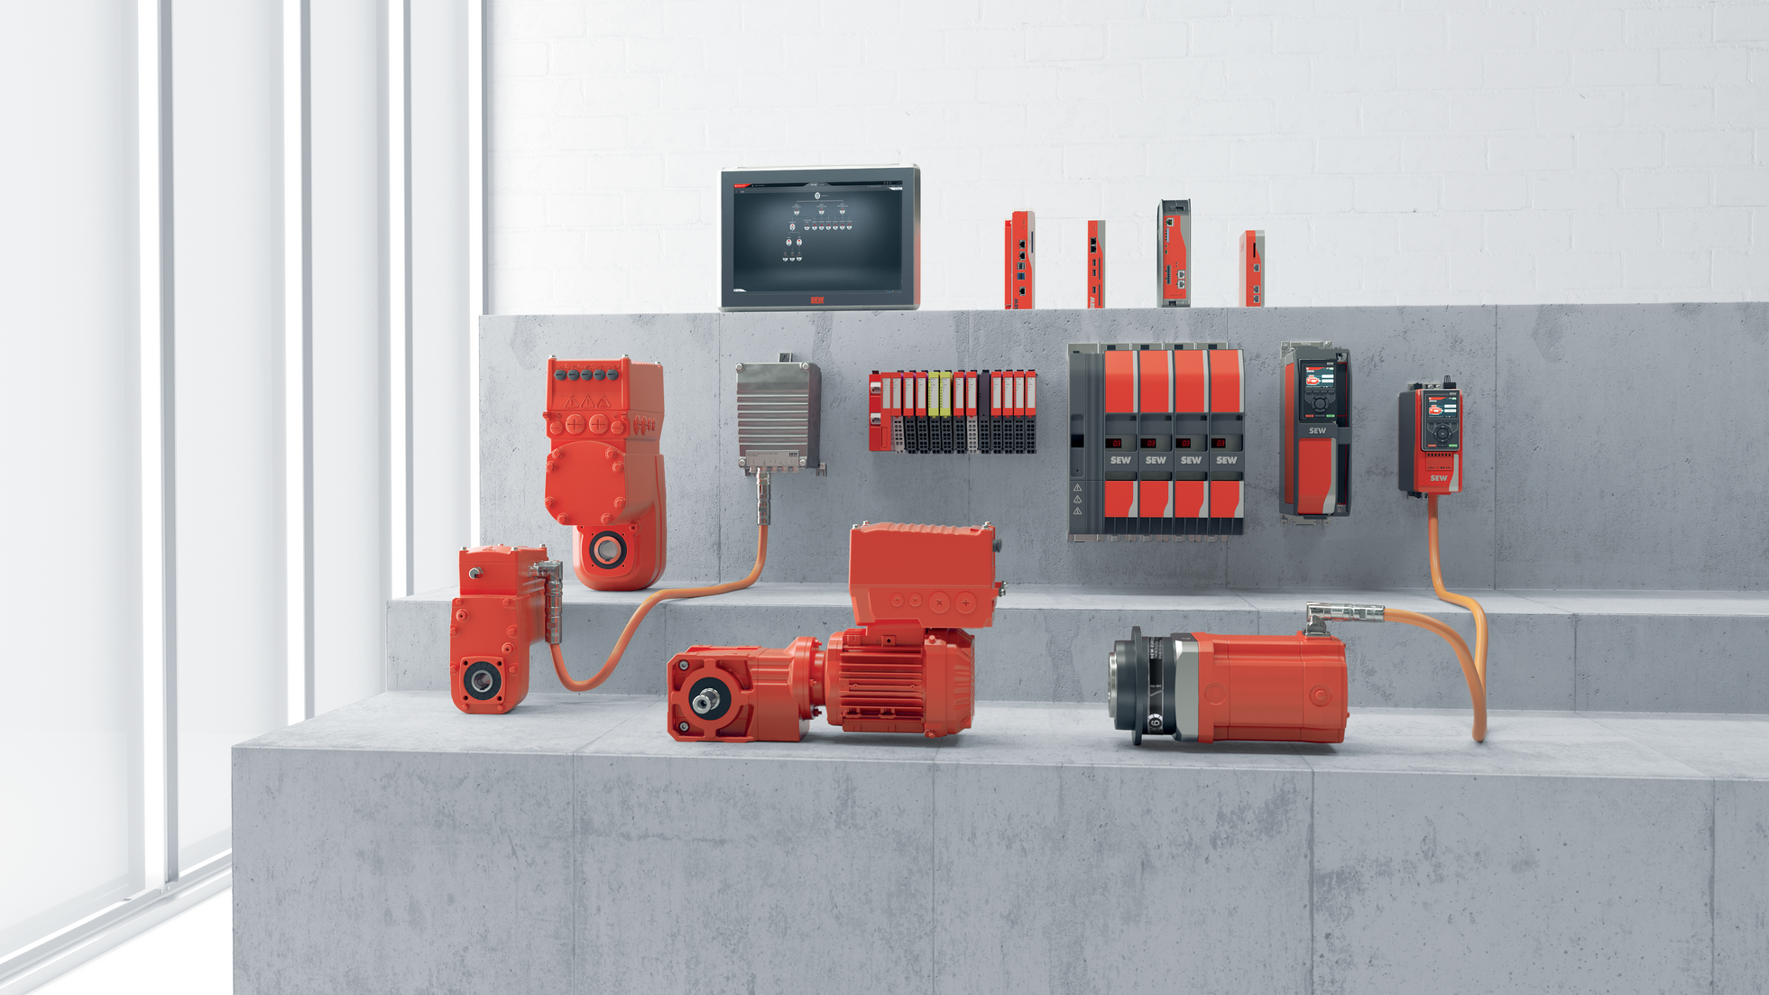

> Solutions Overview
Notes:
Welcome comments and introductions

Slide 2
Three Drivers of Success
Philosophy & Leadership
  Growth with purpose.
People and Facilities
  The real difference maker.
Products & Solutions
  Reliable, efficient, automated.
Notes:
Briefly describe what you’ll be covering.

Slide 3
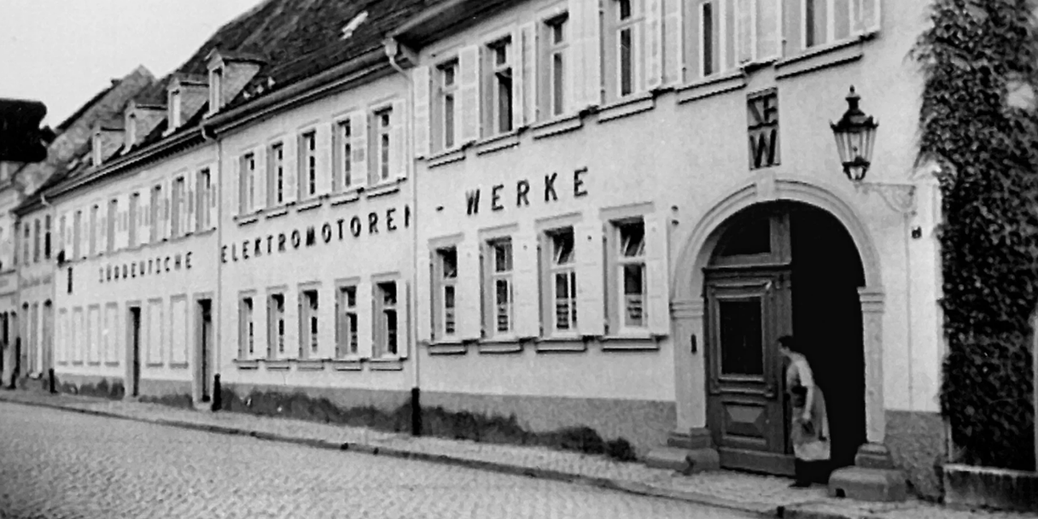

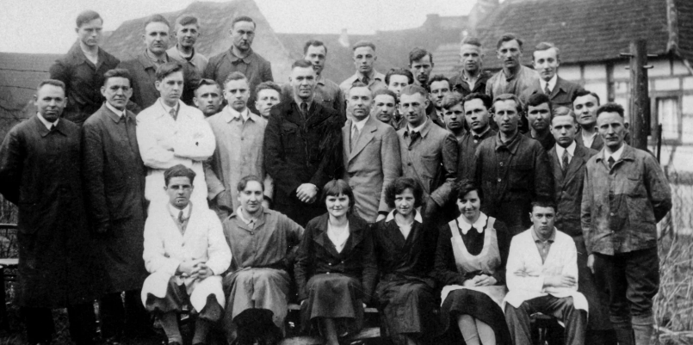
Süddeutsche Elektromotorenwerke
A family affair since 1931
Notes:
Family-owned since 1931
Founded in Bruchsal, Germany.
Ernst Blickle > Great-grandsons Christopher and Rainer Blickle (fourth generation on site in Wellford and Lyman)
Because we remain family owned, we have the freedom to plan with decades in mind, not quarters

Slide 4


Our People: The Real Difference
“Our engineers are the masterminds behind our products, but it’s our people on the floor who ensure the quality and craftsmanship that goes into every unit that we ship daily throughout the world.”
^{Total US Employees}
^{1,100+}
^{Average Tenure}
^{9+ Years}
- Rainer Blickle, VP and Fourth-Generation Owner
^{40+ Years}
¹²
^{30+ Years}
⁶⁵
^{20+ Years}
⁸⁸

Slide 5
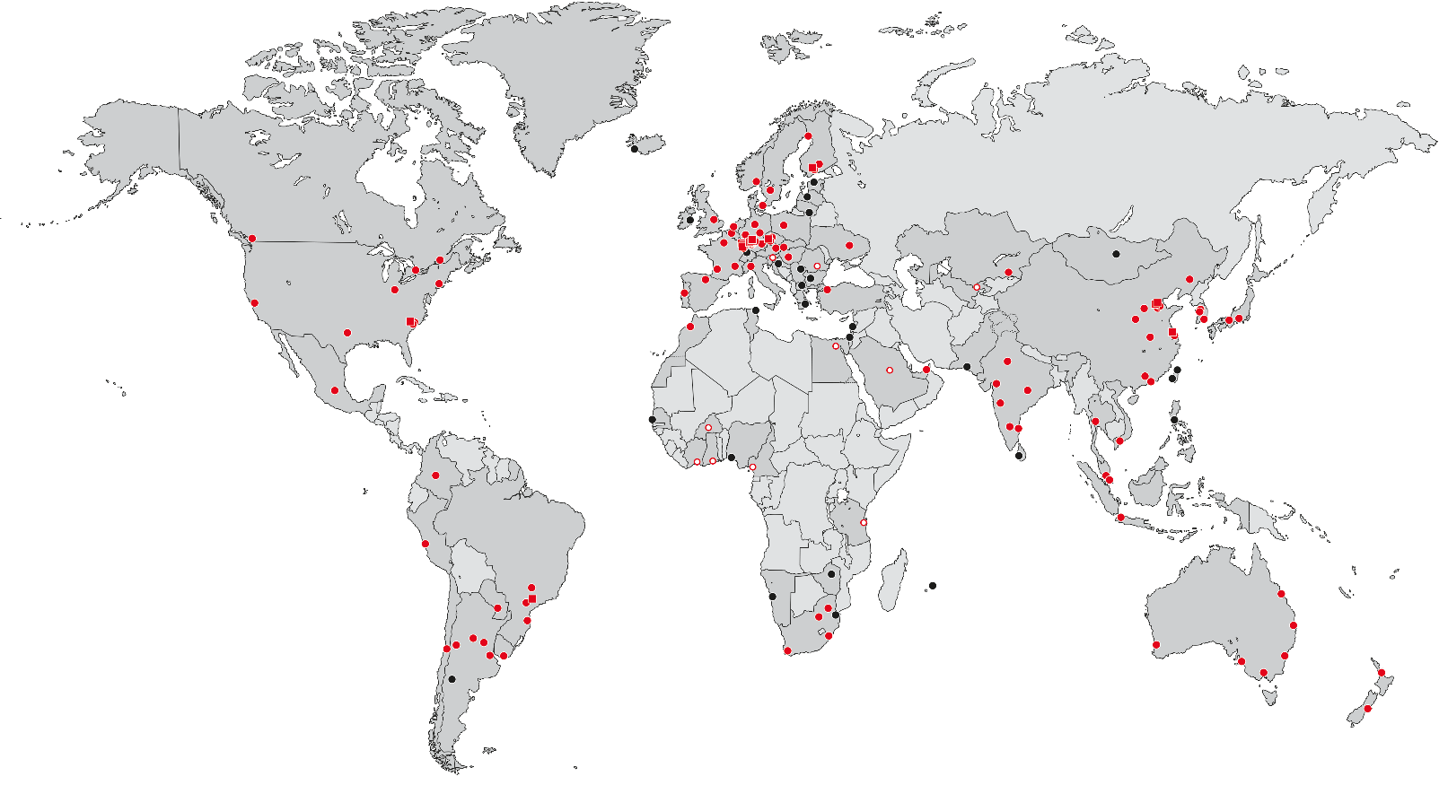
“We have to be where our customers are.”
18 production plants
92 Drive Technology Center
> 200 sales companies
38 partners
Notes:
We span six of the seven continents and appoximately 57 countries. This global reach fulfills our mission to provide quicker delivery time and better overall customer support our customers deserve.
When selecting new Assembly locations, no matter where in the world, we carefully consider regional customer needs and logistics.
We seek expansion and growth – only when it adds efficiencies and passes a higher level of service and value to customers.

Slide 6
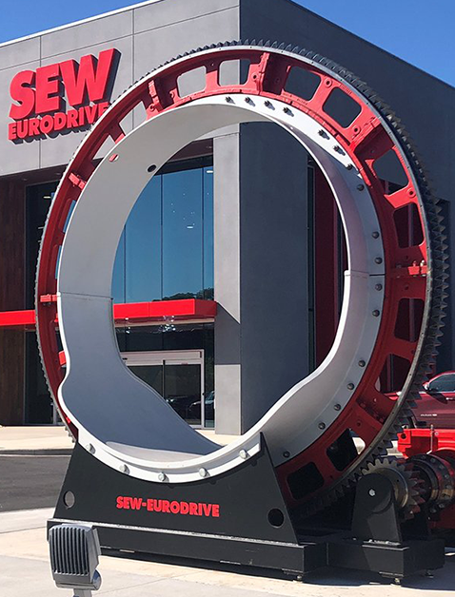
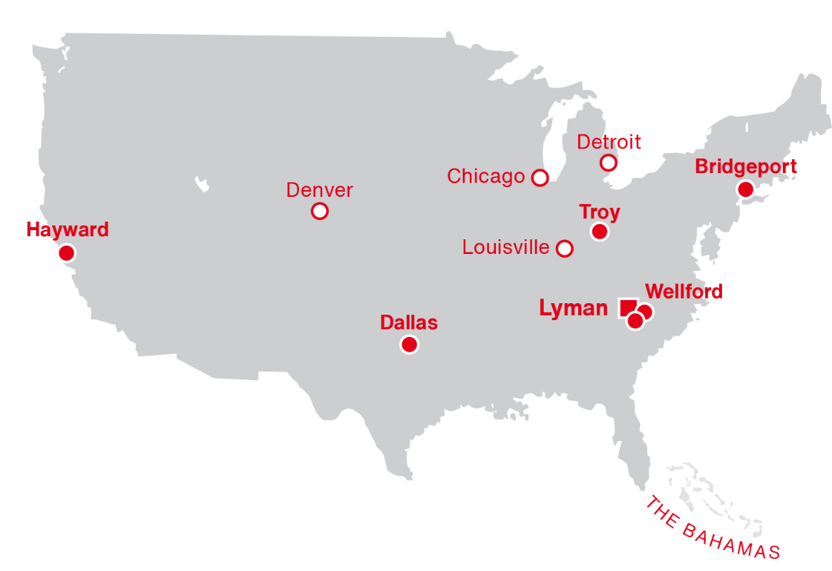
U.S. Operations
Established
Headquarters
1975
Wellford
Boston
Production plants: 1
Service and Sales Support: 5
Drive Technology Centers: 6

Slide 7
Three components that make our facilities second to none.
Our Facilities
High-Efficiency Processes
Unparalleled Quality Control
Precise Engineering
Automated processes using our drive technology and electronic solutions.
Every unit is tested for performance with
climate-controlled labs.
State-of-the-art technology that scans and measures
our geometric tolerances down to the micron!

Slide 8
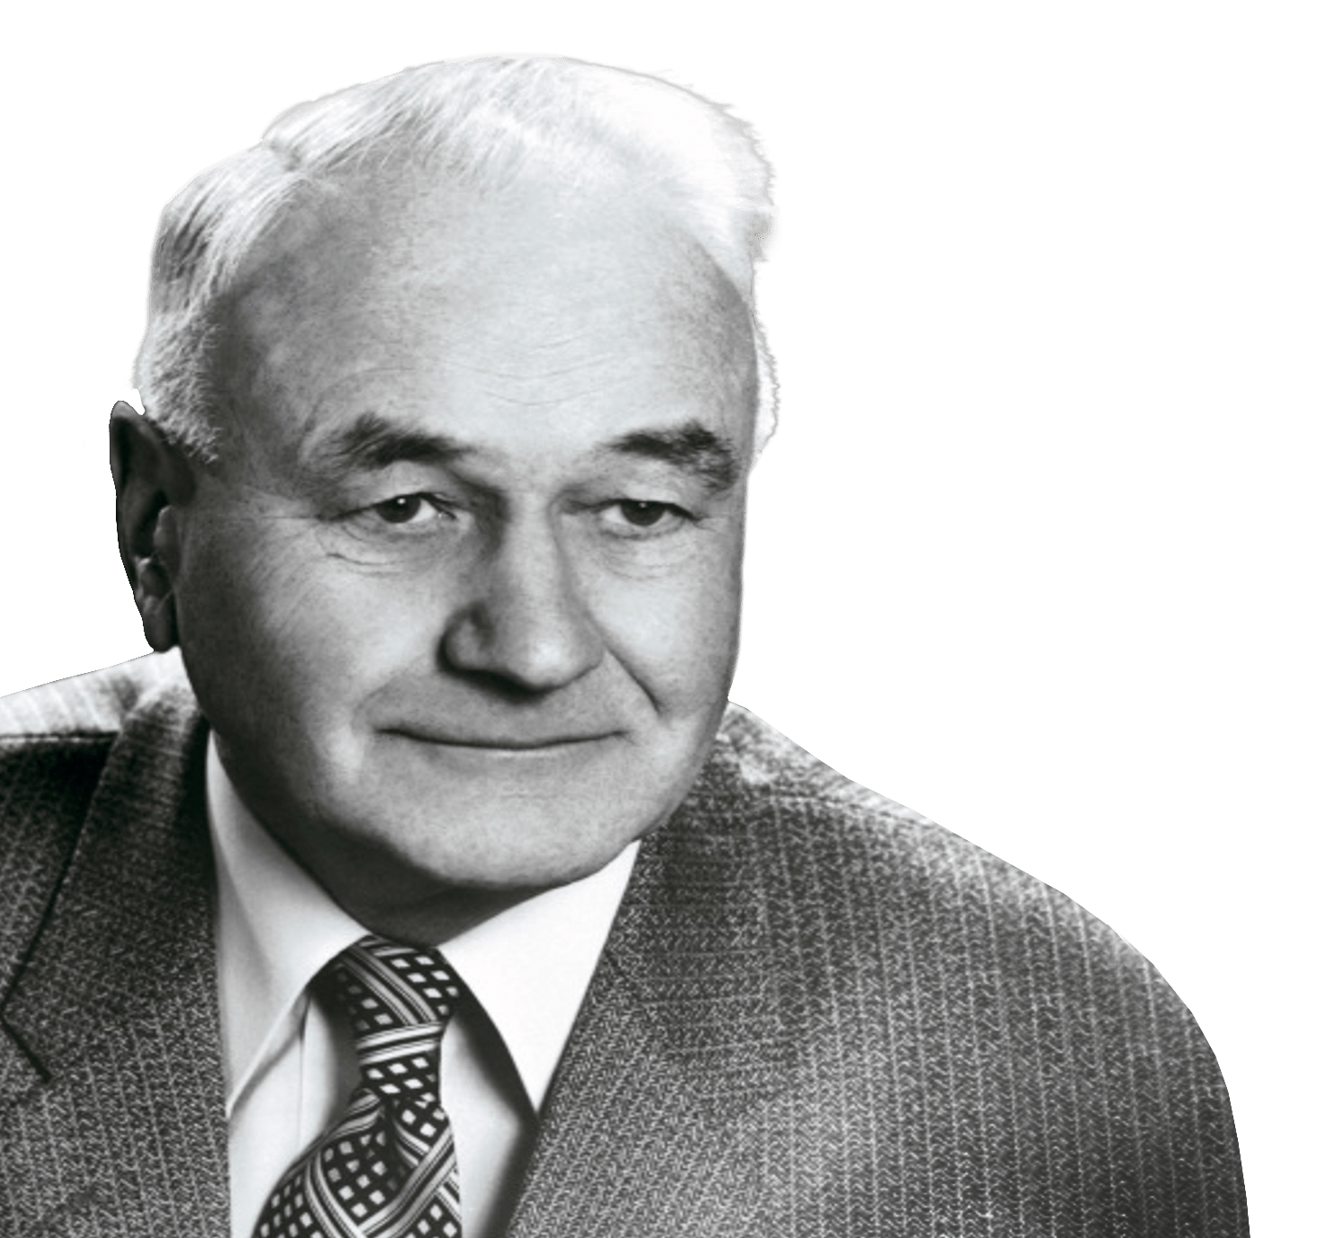
Our Credo (since 1931):
“People don’t want products – they want solutions.”
Ernst Blickle
Son-in-law of the founder of
Süddeutsche Elektromotoren-Werke (SEW)

Slide 9
Machine
Automation
Complete Drive Solutions For Factory and Machine Automation
From beginning to end of line.
Gear Units and Motors
Services & Support
Gear Units
AC Motors
Servo Drive
Technology
Low Voltage
DC drives
Heavy Industry
Gearing
Online Support &
Product Service
Drives & Controls
Complete Automation
Motion
Controllers
Decentralized
Drives & Inverters
Cabinet Mount
Drives & Inverters
Machine
Automation
Factory
Automation
Software

Slide 10
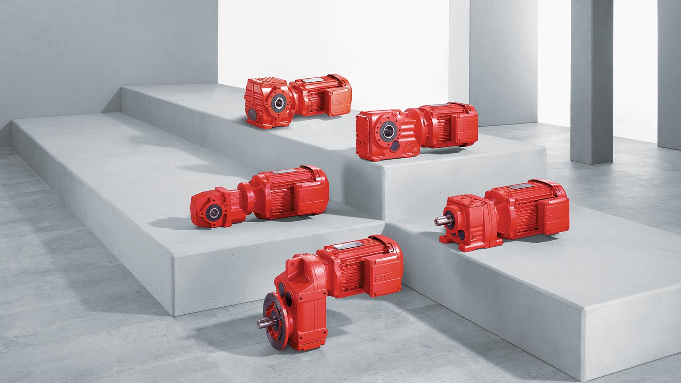

Gear Units and Motors

Slide 11

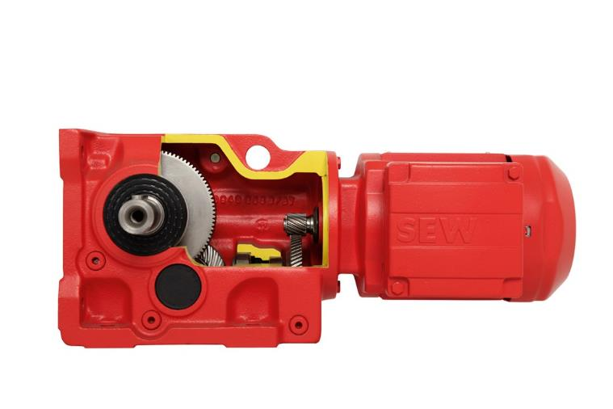
Modular Gear Units
Overview
SEW offers a full line of high-efficiency gearmotors built for reliability and durability, and modularity – no matter the application
or industry.
Highlights
Modular platform for a wide range of drive applications.
Available in parallel-shaft, right-angle, and inline designs.
Global modular concept guarantees consistent product and parts availability.
Technical Notes
Torque range to 469,000 lb-in.
Compatible with AC and servo motors including IE5 efficiency
Multiple frame sizes and finely stepped gear ratios
Easy online configuration tool
Complete Overview
Notes:
R Series — Inline helical gear units and gearmotors, available in single- or multi-stage configurations
K Series — Right-angle gear units and gearmotors with highly efficient helical-bevel and/or hypoid gearing
S Series — Right-angle helical-worm gear units and gearmotors. Economical, wear-free design.
W Series — Right-angle economical gearmotors with SPIROPLAN® gearing
F Series — Slim design parallel shaft helical gear units and gearmotors
Stainless Steel — Available in right angle and inline configurations, stainless gear units meet IP69K standards for wet areas subject to frequent cleaning.
Mixer and Screw Conveyor Drives — Optimized motor and gear unit options for mixing, agitating, and screw conveyor applications. Specialized options for extended bearing and seal life
TorqLOC® — simple to use hollow-shaft shrink disc mounting system for use between the machine shaft and the gear unit
Explosion-proof gear units — Conforms with the most important regulations and standards for the global market, from ATEX to IECEx to HazLoc-NA®

Slide 12
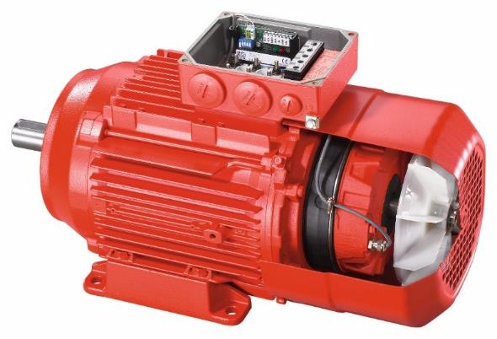
AC Motors
Overview
SEW-EURODRIVE AC motors feature a broad range of power, efficiency, and configuration options.
Highlights
Motors can be configured with brakes, encoders, forced cooling fans, and multiple connector options.
Built on a standardized platform with worldwide engineering, production, and service support.
Suitable for conveyors, packaging systems, material handling, food & beverage, and other industrial automation applications.
Technical Notes
Sizes: fractional to 500HP and efficiency classes up to IE4
Available in 2-, 4-, 6-, and 8-pole versions.
Standard AC motor frame sizes from 56 to 355
Compatible with MOVIMOT® motor-mounted inverter
Complete Overview

Slide 13
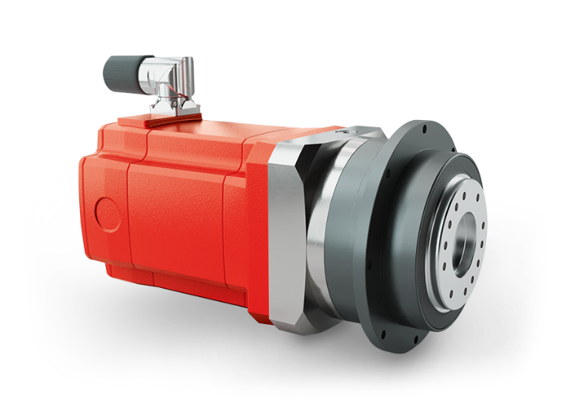
Servo Motors and Gear Units
Overview
SEW’s line of compact, low to medium inertia synchronous servomotors are available in multiple frame sizes, lengths, and speed classes.
Highlights
High-precision positioning for servo-driven motion control applications.
Pair with our PxG planetary servo gear units, or the full line of SEW modular gear units.
Compatible with SEW inverters and the MOVI-C® automation platform.
Technical Notes
Multiple frame sizes, lengths, and speed classes.
Torque range to 320 Nm, ratios from i = 3 to i = 100
Backlash as low as 1 arcmin
Brake, feedback, and connector options
Complete Overview

Slide 14
Low Voltage Drives
Highlights
Combines compact 48 V DC motors with parallel, right-angle, and planetary gear units for flexible drive configurations.
High power density with smooth running and overload capability.
Optimized for warehouse, conveyor, shuttle, and AGV applications.
Paired with MOVIMOT performance ELV for advanced motion control within our MOVI-C platform.
Overview
Compact extra-low voltage drives provide efficient 48 V DC motion solutions for warehouse and logistics automation
when space is limited.
Technical Notes
Fully integrated controls with configurable analog and digital interfaces.
300% overload capacity.
Optional onboard Ethernet/IP, PROFInet®, and EtherCAT®
188–356 W rated power.
Complete Overview

Slide 15
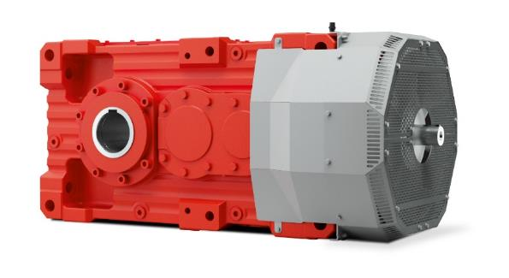
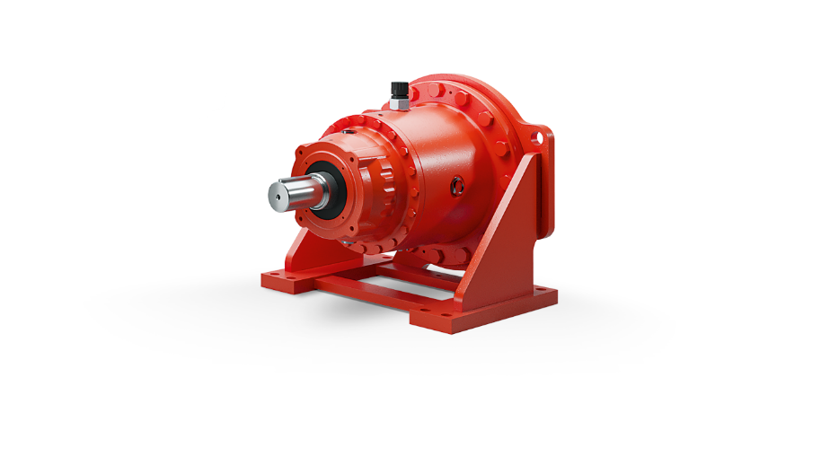
Heavy Industry Gearing
Highlights
Modular platform for application-specific configurations, including helical, bevel-helical, and planetary gear unit designs.
Available as complete drive solutions with engineering, startup, maintenance, repair.
Supports both SEW-EURODRIVE and third-party equipment through
a global industrial gear unit service network.
Overview
Heavy-duty drive solutions designed for demanding high-torque applications in industrial environments.
Technical Notes
X.e series gear units: 23 sizes, 7.2 – 500 kNm torque rating,
6.3 – 450 ratio
P/P2.e series planetary gear units: 11 sizes, 24.8 – 631 kNm torque rating, 15 – 5,000+ ratio
M1.N series: 12 sizes, 1.4 – 189 kNm torque rating, 1.0 – 7.1 ratio
Segmented girth gears: external gearing typically driving rotating mills & kilns; up to 52 ft diameter!
Complete Overview

Slide 16
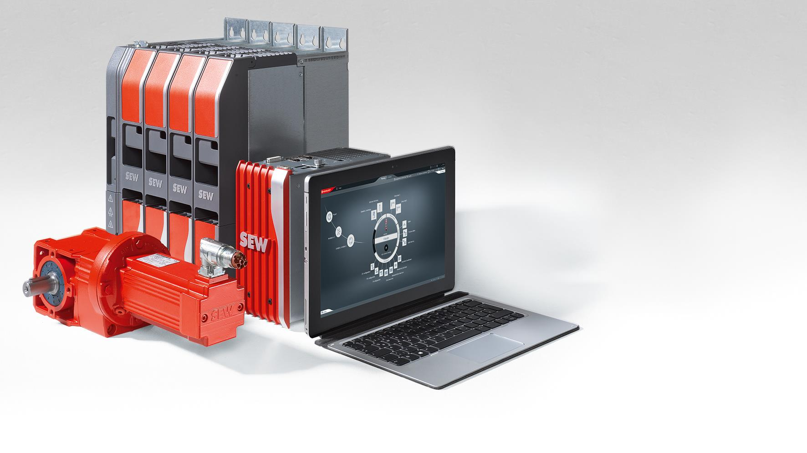

Drives
and Controls
MOVI-C® Modular
Automation System
Notes:
Describe MOVI-C: Hardware and software from a single source: Seamless integration with controls, components, and software.

Slide 17
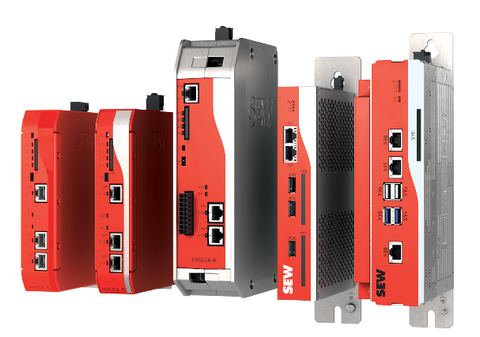
Motion Controllers
Overview
Designed for challenging motion control tasks or simple single axis applications alleviating the main PLC load. Several performance classes available.
Highlights
Enables synchronized multi-axis motion.
Supports custom and pre-engineered automation functions.
Common controller platform for both centralized and decentralized automation architectures, including SEW’s MOVI-C
Technical Notes
Integrated interface for all standard control systems
Up to 32 interpolated axes for multi-axis motion control
FSoE, PROFIsafe, other functional safety options
EtherCAT protocol for real-time communication with our drives.
Complete Overview

Slide 18
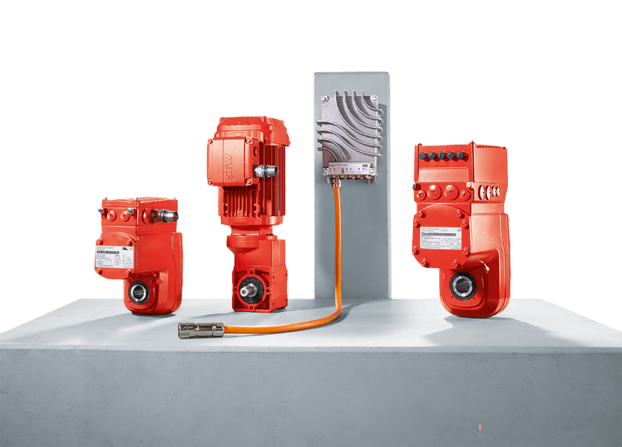
Decentralized Drives & Inverters
Overview
SEW-EURODRIVE's Decentralized Drive Technology portfolio combines decentralized inverters, controllers, and mechatronic drive systems for machine-level automation.
Highlights
Control-cabinet-free architecture moves intelligence and drive electronics closer to the machine, reducing wiring complexity.
Supports modular, flexible production for rapidly changing manufacturing and conveyor layouts.
Single-source automation ecosystem integrates drives, controllers, software, and communication through the MOVI-C® platform.
Technical Notes
Up to 50% lower energy consumption possible with MOVIGEAR IE5 mechatronic drive.
Lower installation costs compared with centralized architectures in large systems.
Single-cable MOVILINK® DDI interface provides power and communication for decentralized components.
Complete Overview

Slide 19
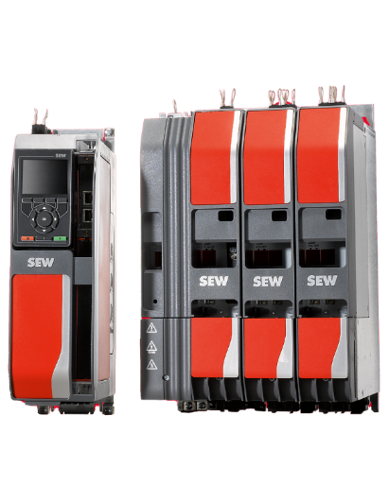
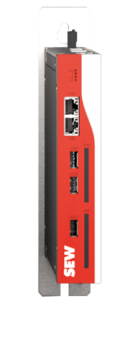
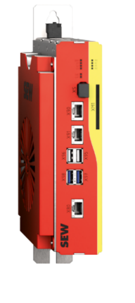
Cabinet Mount Control
Overview
MOVI-C® inverters, controllers, and functional safety components for a wide range of motion control applications.
Highlights
Provides one platform for all drive applications across centralized and decentralized architectures.
Reduces engineering complexity through integrated control, communication, and software tools.
Supports a wide range of motor technologies from standard AC motors to servo motors.
Technical Notes
Single-axis application inverters are available with rated outputs up to 315 kW.
Modular multi-axis systems support rated currents up to 180 A.
Inverters provide overload capacity of up to 250% for dynamic motion applications.
Complete Overview

Slide 20
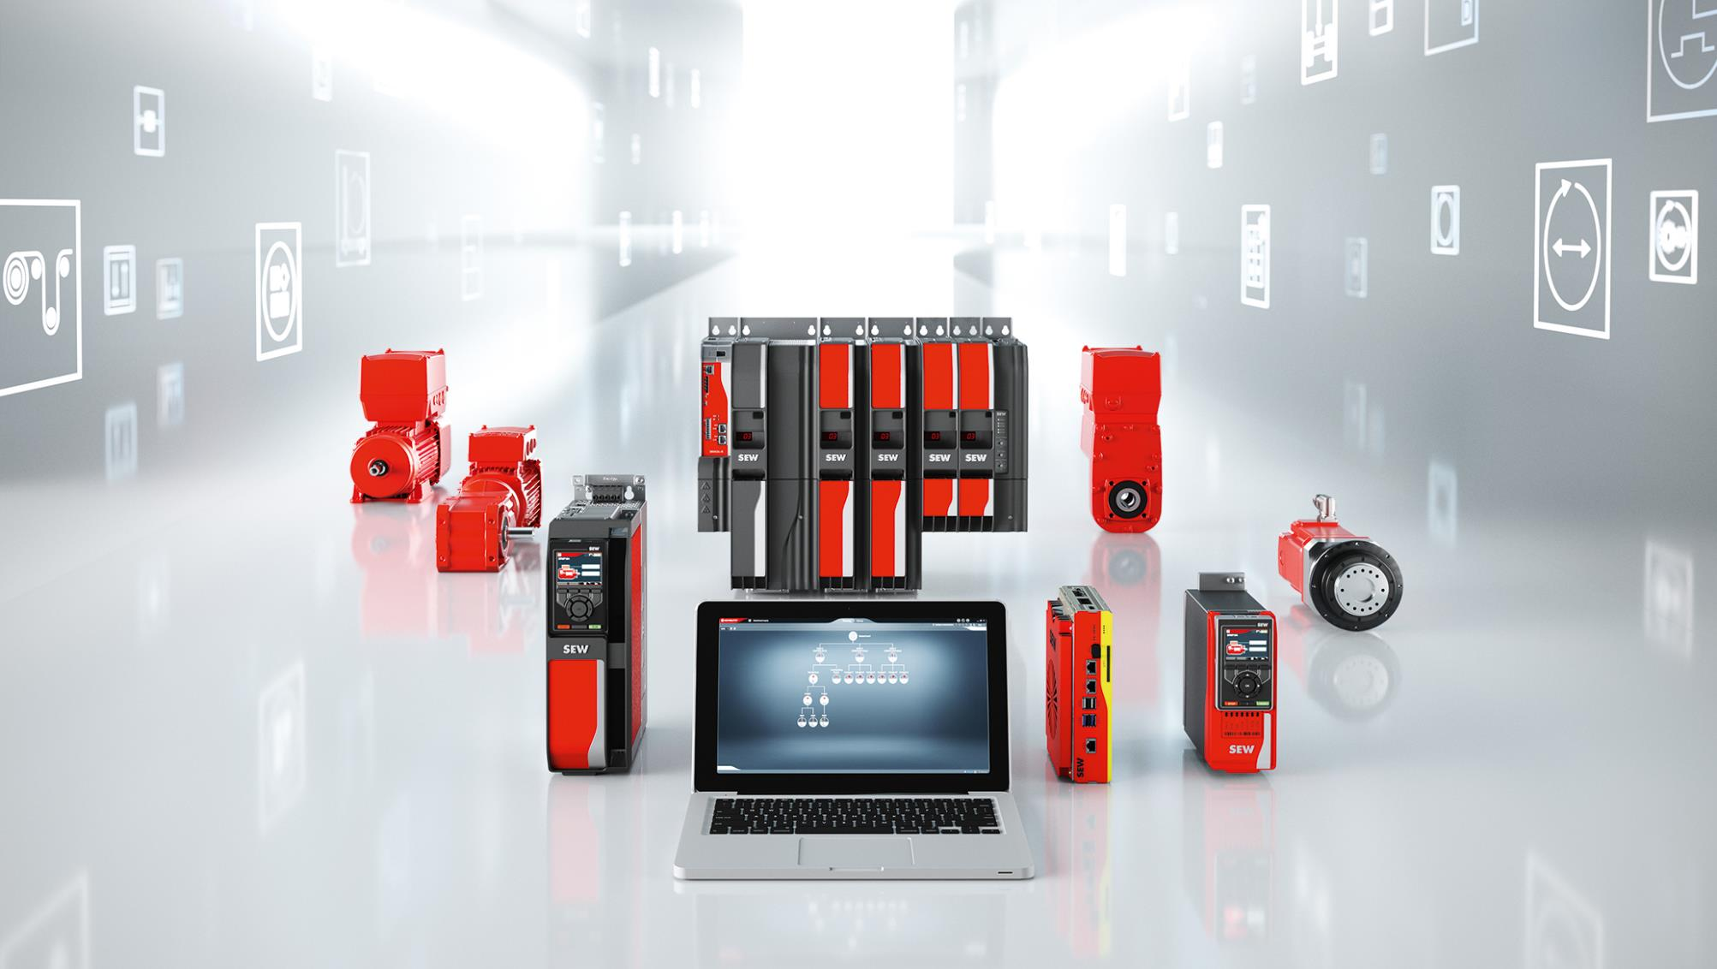
Complete Automation

Slide 21
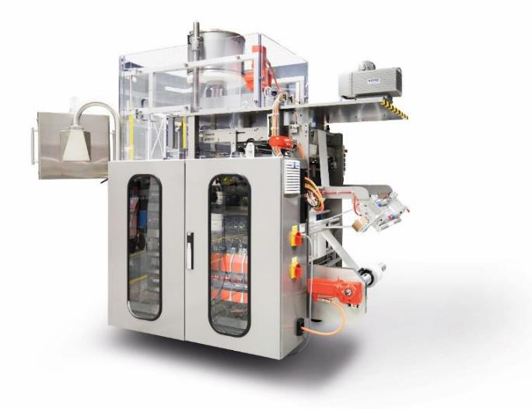
Machine Automation
Overview
Modular machine automation solutions for flexible, end-to-end industrial production of many machine types.
Highlights
Supplying the entire motion stack, from the motor to the motion controller
Components include controllers, motors, software, safety, and networking (PROFINET, EtherNet/IP, EtherCAT, OPC UA)
Capabilities for single and multi-axis positioning, electronic gearing, pick-and-place, delta and articulated robot kinematics, conveyor synchronization, and more.
MOVI-C® modular automation platform - Reduce complexity and startup time with this true future-proof machine automation platform. This single-source solution includes controls, components and software all designed to work together seamlessly.
Individual components also compatible with other system architectures.
Complete Overview

Slide 22
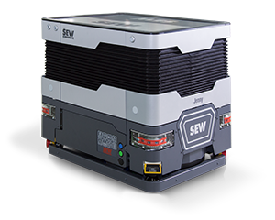
Factory Automation
c
Overview
MAXOLUTION® provides customized factory automation systems for material flow, production logistics, and intralogistics applications.
Highlights
Covers mobile, autonomous, rail-guided, and line-guided transport technologies.
Includes digital engineering tools such as simulation, fleet management, and system optimization.
Supports implementation from concept development through commissioning and lifecycle support.
MOVITRANS® contactless energy transfer for flexible vehicle power options.
Technical Notes
Supports VDA 5050 fleet interoperability for mobile transport systems.
Cleanroom solutions are available for environments up to ISO 6.
Installed-base services are available with 24/7 support coverage.
Complete Overview

Slide 23
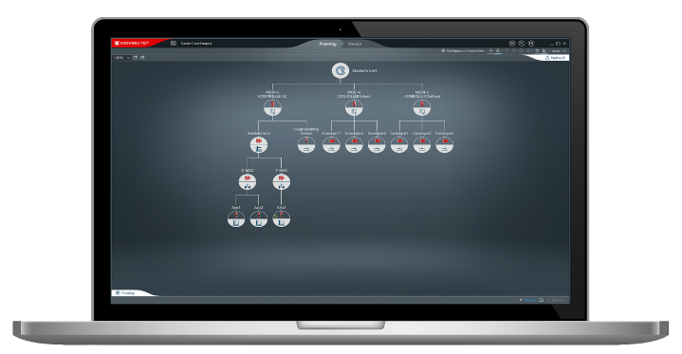
Software
Overview
AVAILABLE AT NO COST, SEW engineering software streamlines the planning, commissioning, operation, and diagnostics of automation systems through a unified engineering environment.
Highlights
End-to-end software ecosystem covering engineering, commissioning, diagnostics, visualization, and motion control.
Parameterize instead of program using preconfigured MOVIKIT® modules to reduce development and startup effort.
Single software platform integrates drives, controllers, gear units, and automation components through MOVI-C® architecture.
Technical Notes
MOVIKIT® software modules cover motion, robotics, communication, and automation.
MOVIKIT® Robotics supports 3-axis and 4-axis pick-and-place applications.
MOVIKIT® OPC UA provides both server and client functionality.
Complete Overview

Slide 24
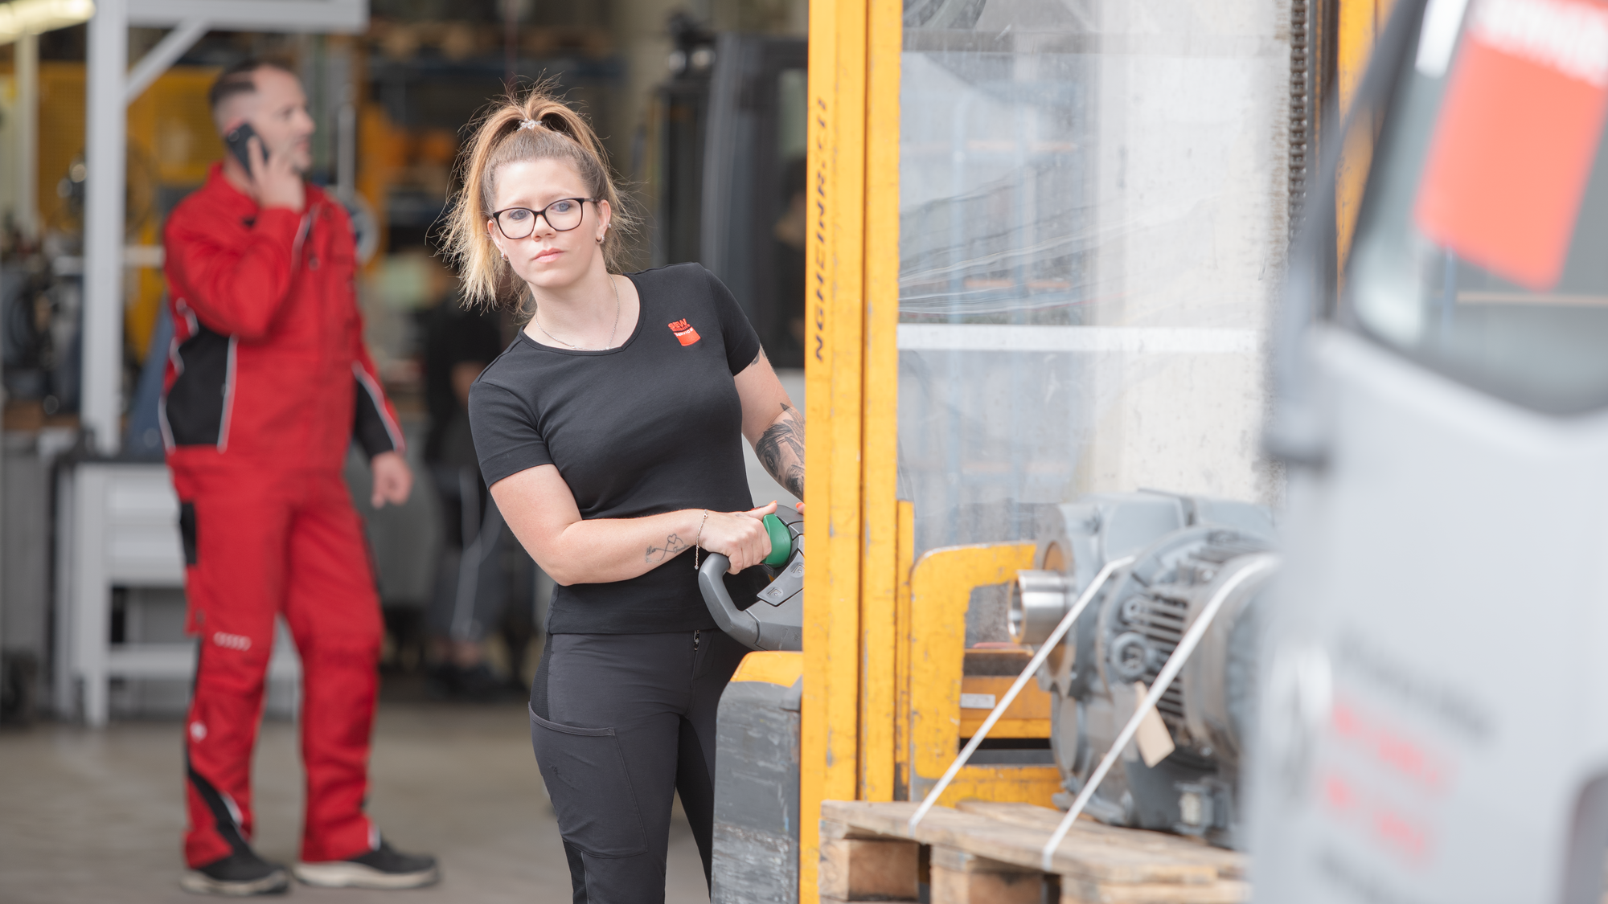

Service & Support

Slide 25
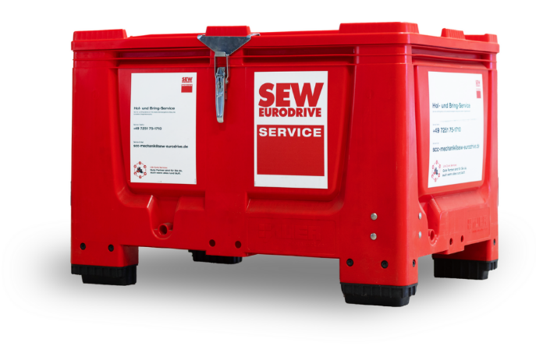
Service Types
Overview
SEW-EURODRIVE provides comprehensive after-sales support, from condition monitoring and online assistance to live consultations with our technical experts.
Highlights
DriveRadar® - condition monitoring and predictive maintenance
Red Box Pickup: collection box for service repair for high-volume facilities
Digital Services Cockpit - single access point for product information
Online Support
24/7 Hotline
Service and repair at our facility, at authorized service partners, or onsite
Complete Overview

Slide 26
xxx
c
xxx
xxxx
Highlights
Xxx
Xxx
Xxx
Technical Notes
Xxx
Xxx
Xxx
Image with white or transparent background here.
Complete Overview

