Slide 1

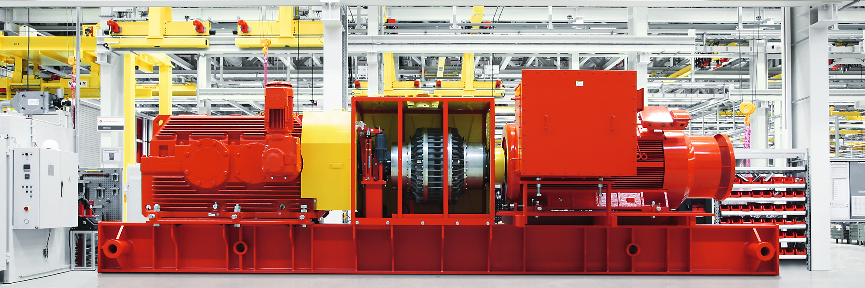
Heavy Industry Gearing (HIG)
Products and Capabilities

Slide 2



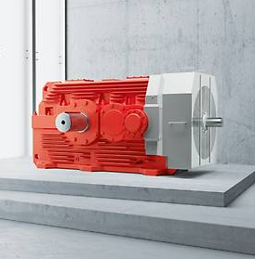
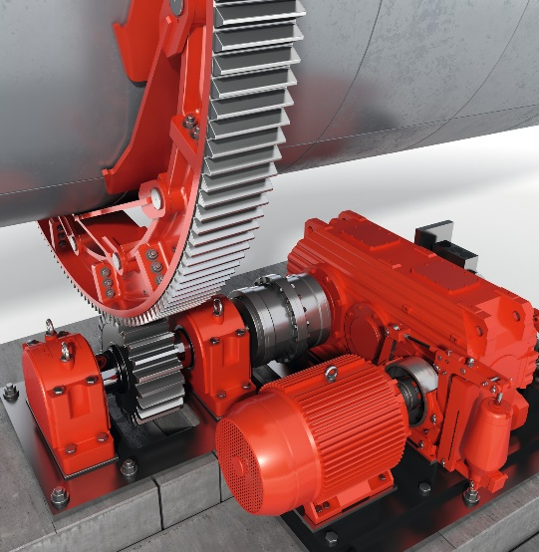
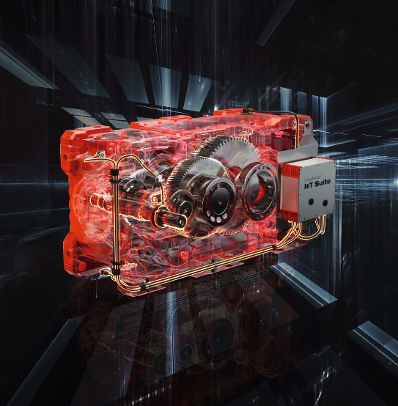
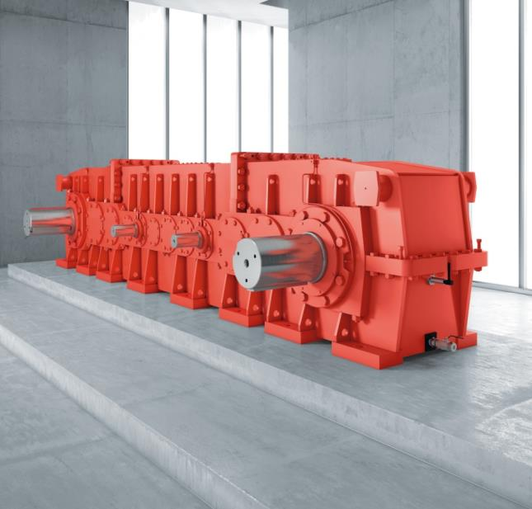
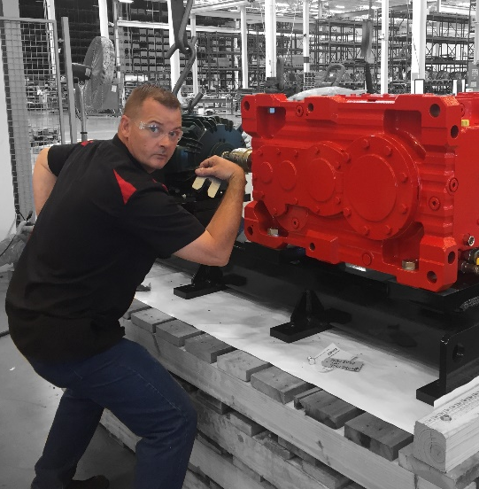
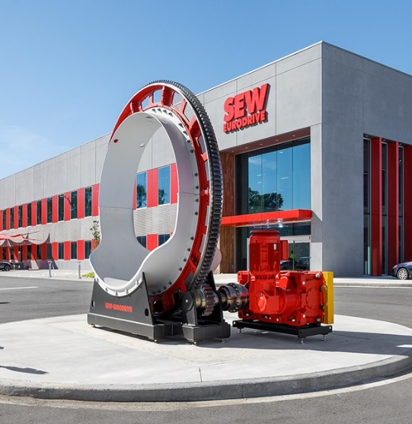

Agenda
01
What is HIG?
02
SEW HIG USA
03
Product Overview
04
Applications
05
HIG + Automation
06
Custom Designs
07
Our Team
08
Summary

Slide 3
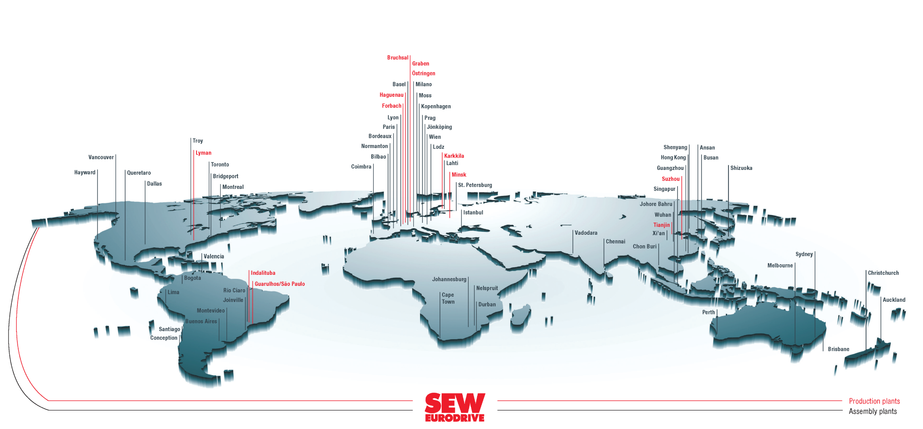
01 - What is HIG?
About Us
Over 90 years of experience
> $4.57 billion in sales (2022)
88 Drive Technology Centers
54 countries
22,000 employees
17 production plants
“People don’t want products – they want solutions.” – Ernst Blickle

Slide 4
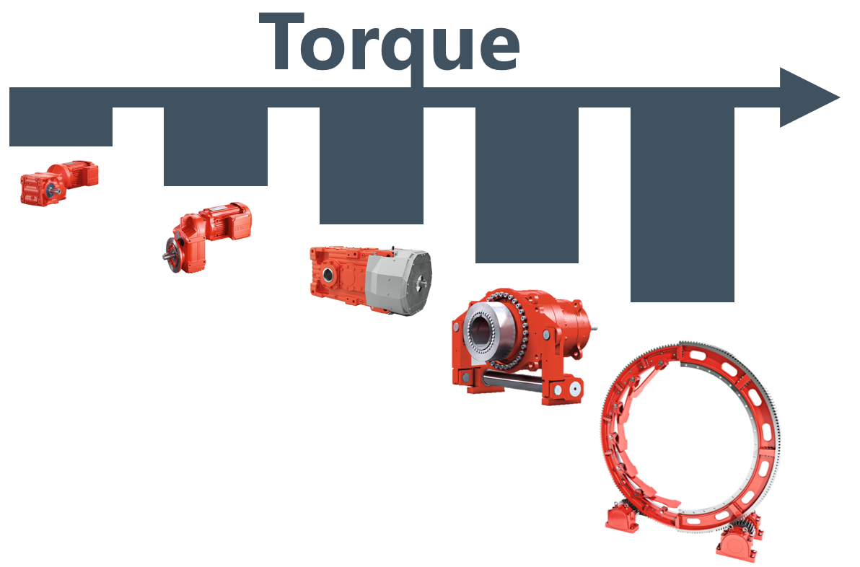

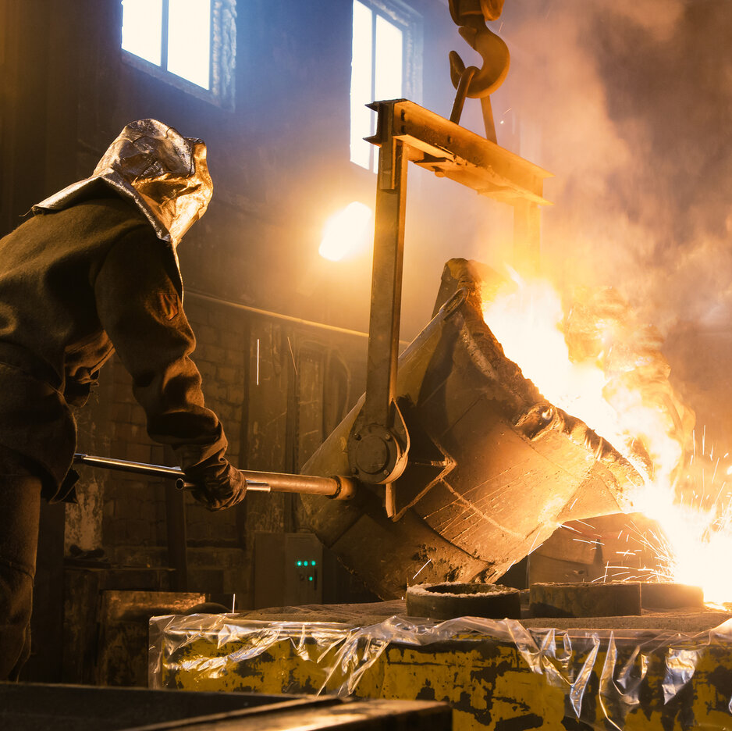
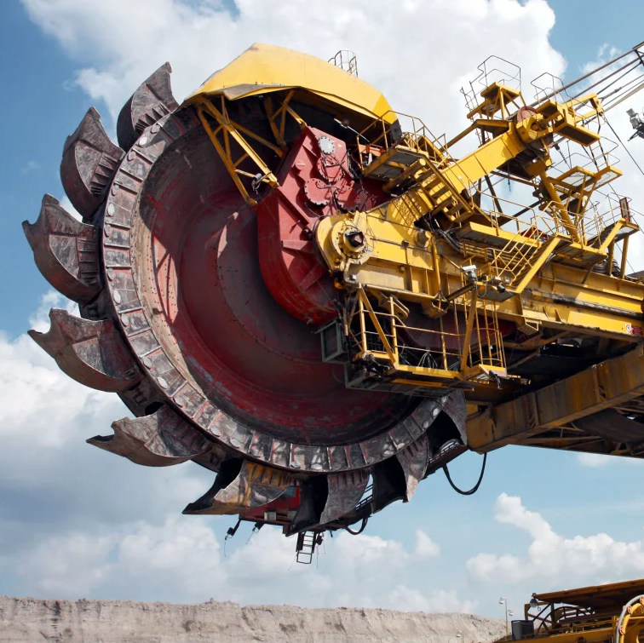
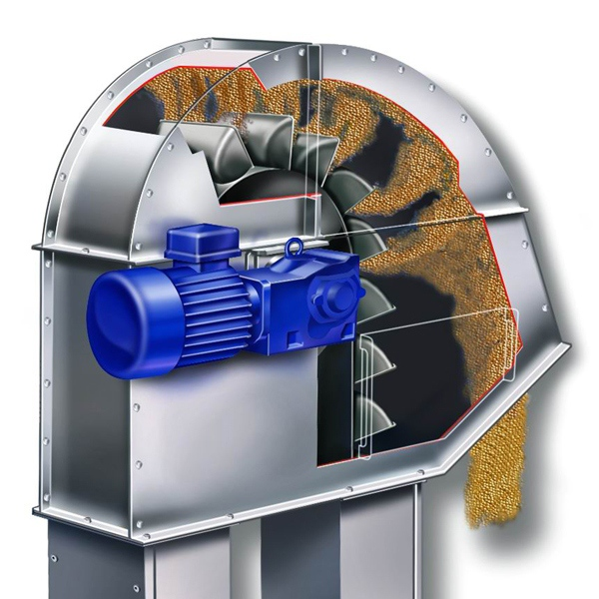
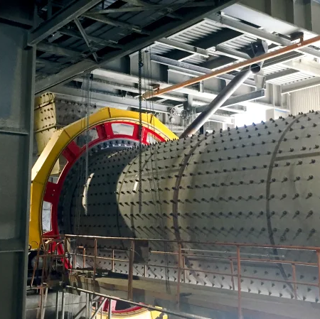

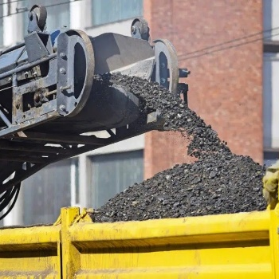
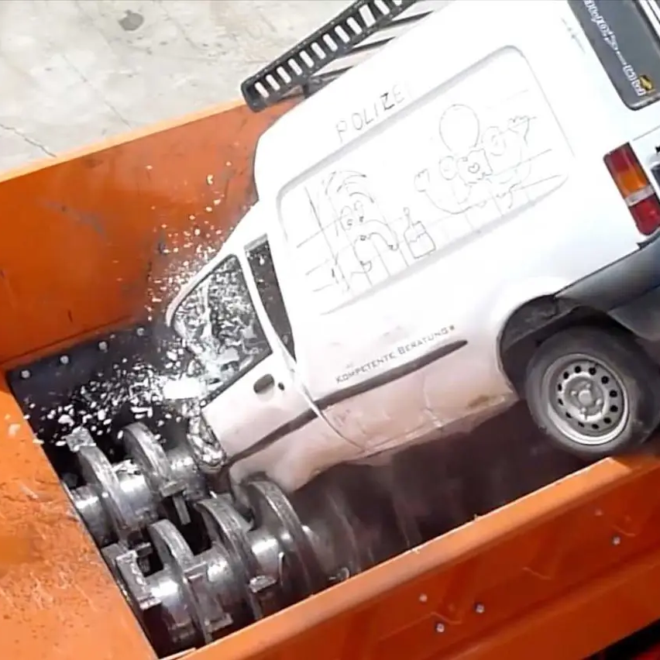
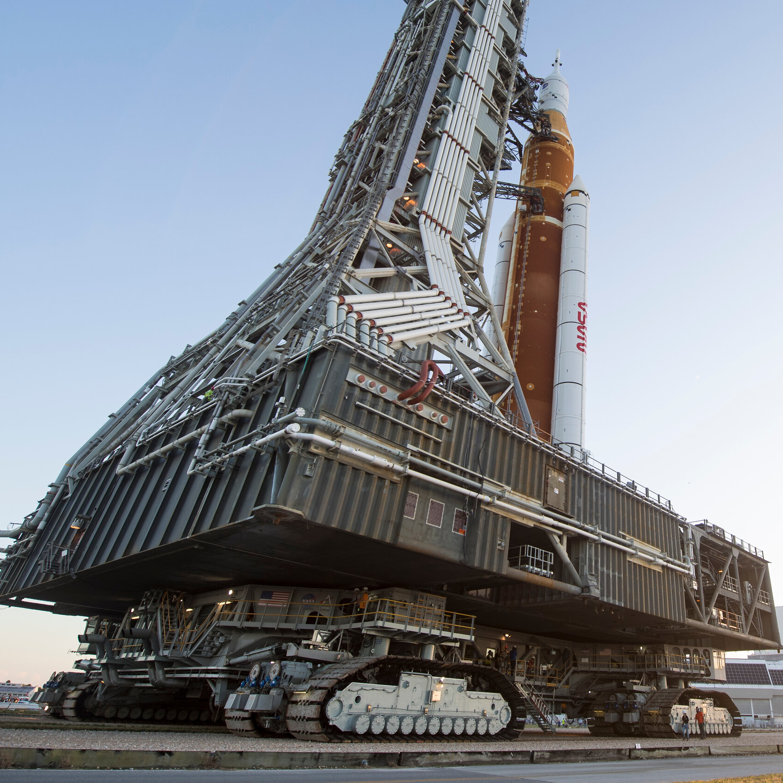
01 - What is HIG?
Heavy Industry Gearing (HIG)
SEW offers an extensive product portfolio
Our high torque product lines are classified as industrial gear (HIG) units
Industrial gearing industries & applications:
General motion
Metal
Mining
Agriculture
HIG
> 60,000 in-lbs
Logistics
Cement
Automotive
Aerospace

Slide 5
Agenda
02
SEW HIG USA
01
What is HIG?
03
Product Overview
04
Applications
05
HIG + Automation
06
Custom Designs
07
Our Team
08
Summary

Slide 6
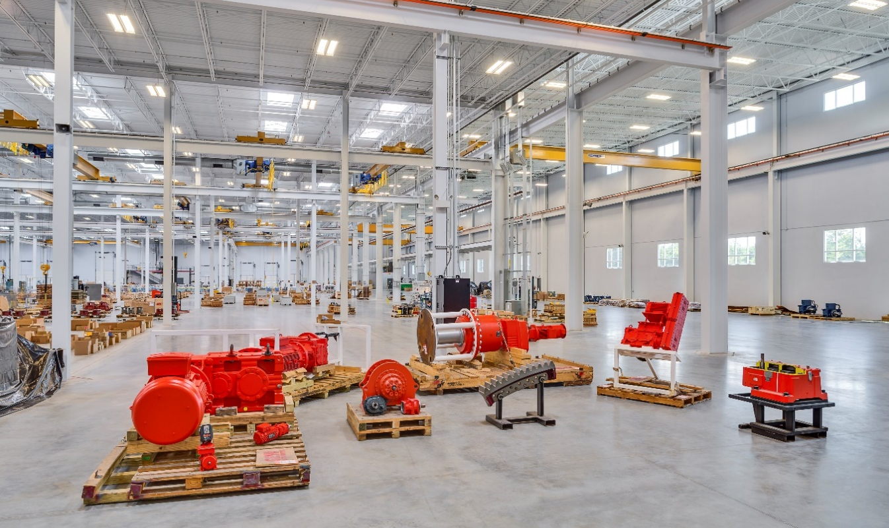
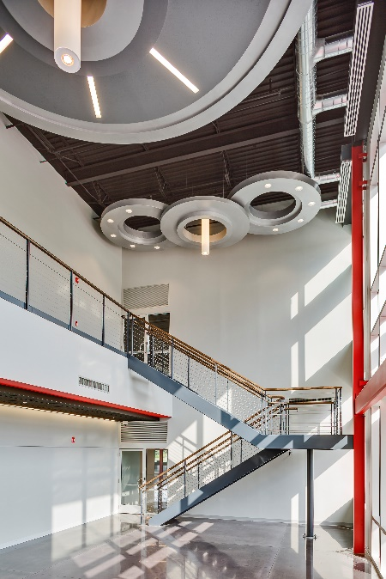
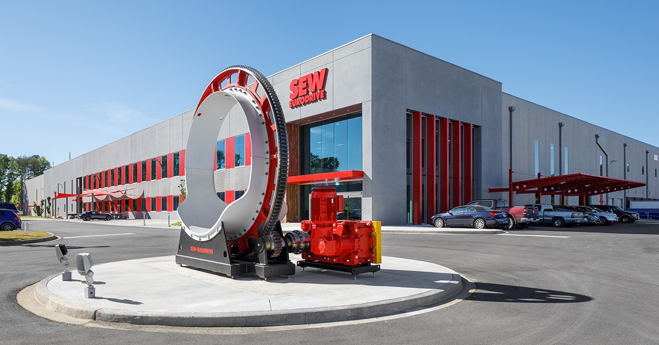
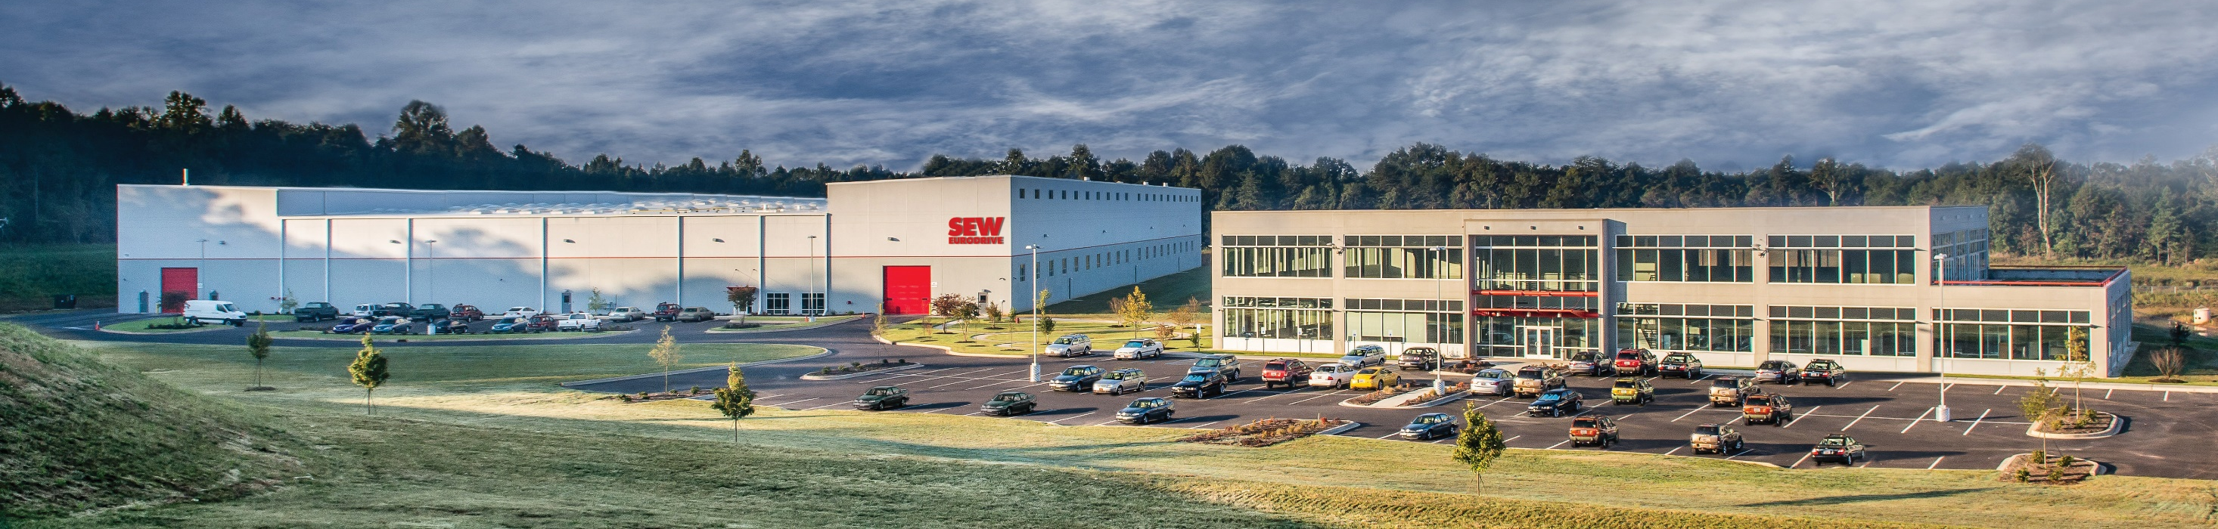
02 – SEW HIG USA
HIG assembly floor
HIG USA
standard product assembly
HIG assembly
HIG & HR offices

Slide 7
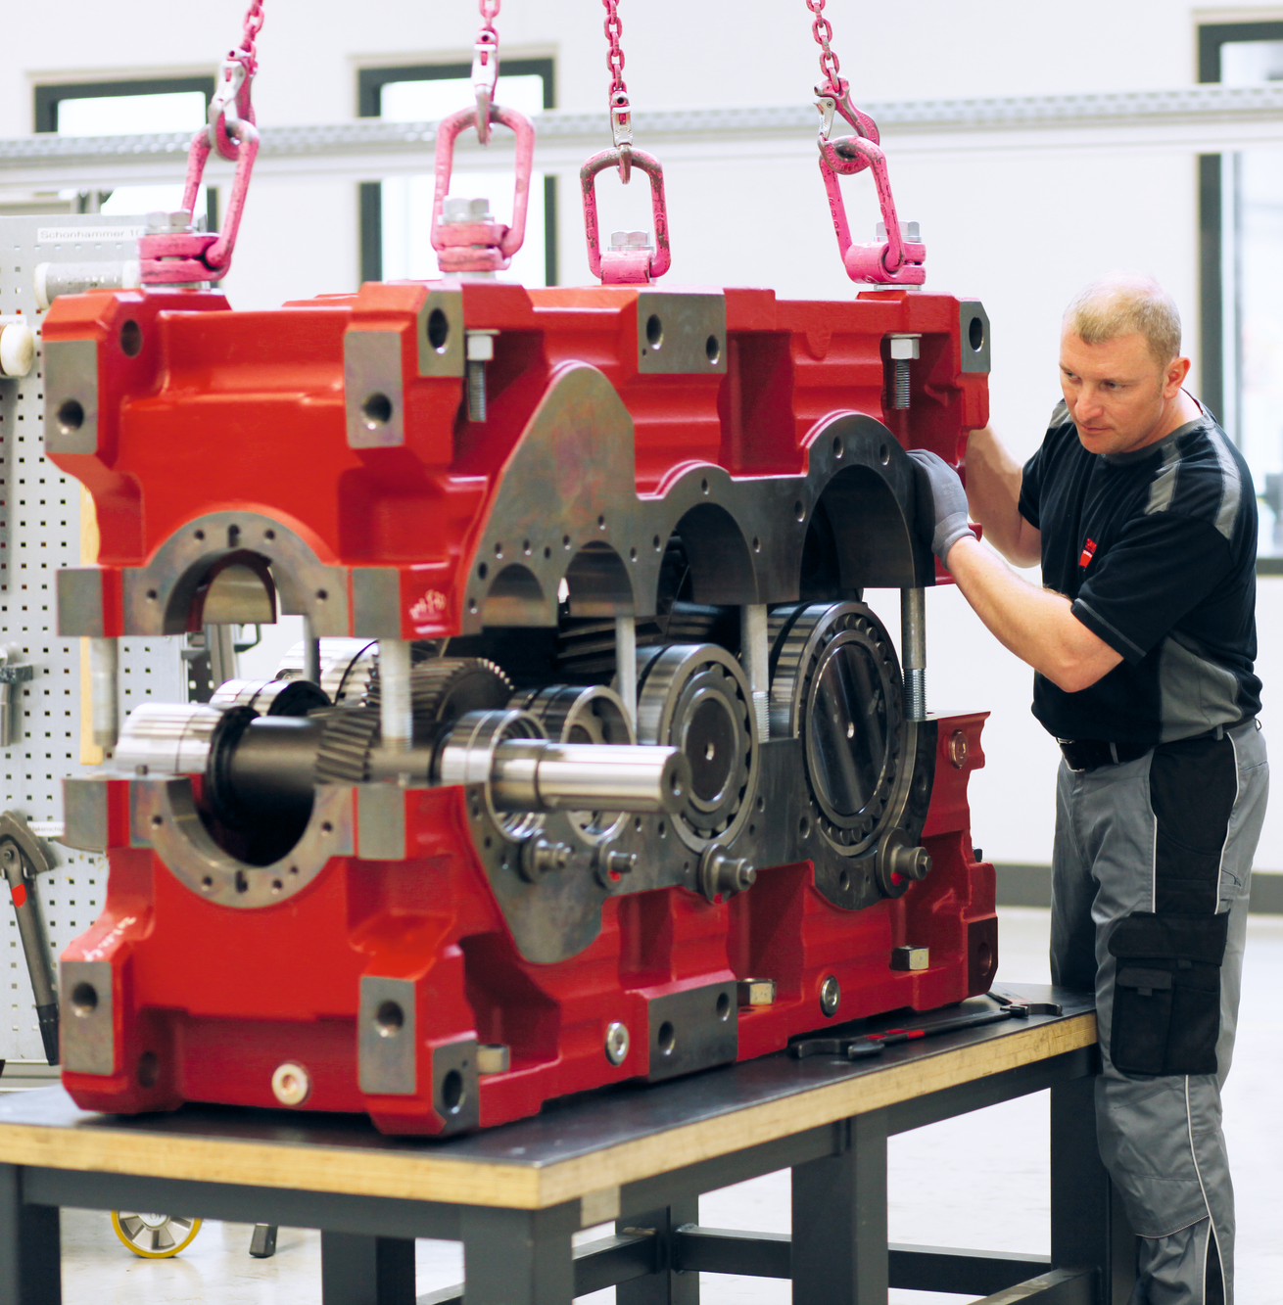





02 – SEW HIG USA
HIG USA – Fast Facts
160,000 ft² of assembly space
Assembly of 4 unique product series and support for many more
Team of engineers, customer service reps, and logistics specialists literally next-door
Service engineers and technicians are on-site, ready for inspections & rebuilds
Expedite delivery team

Slide 8
Agenda
03
Product Overview
01
What is HIG?
02
SEW HIG USA
04
Applications
05
HIG + Automation
06
Custom Designs
07
Our Team
08
Summary

Slide 9
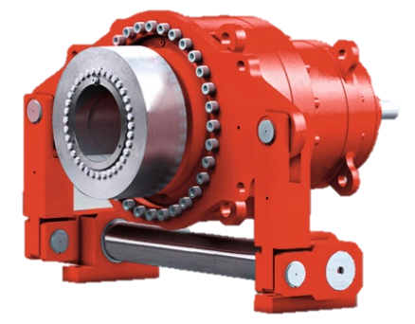
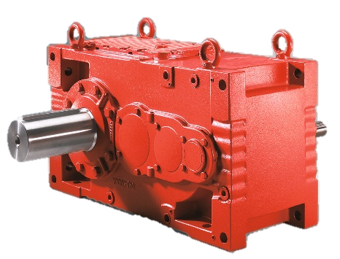
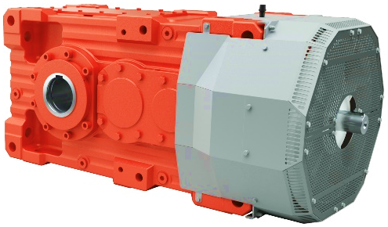
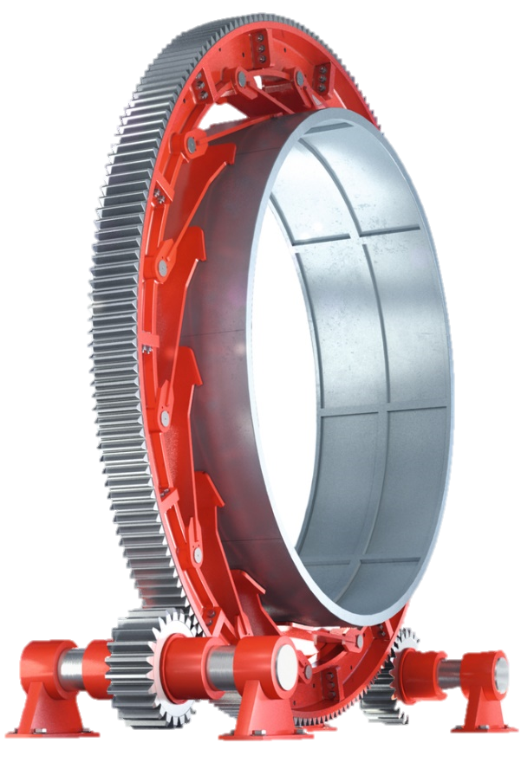
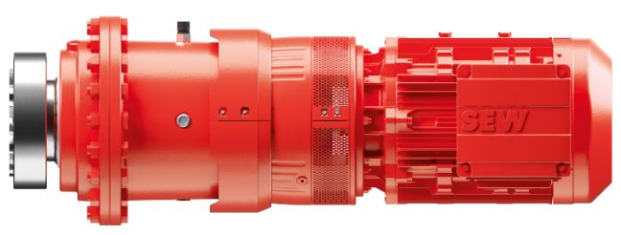
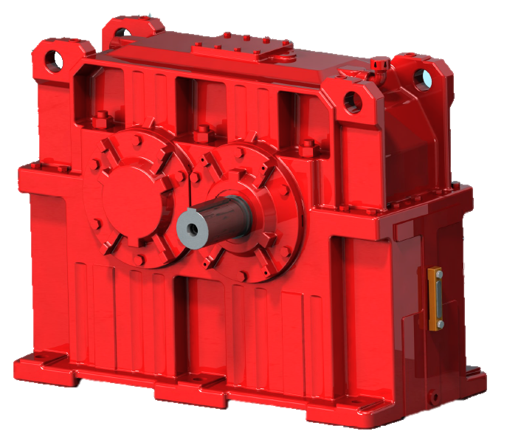
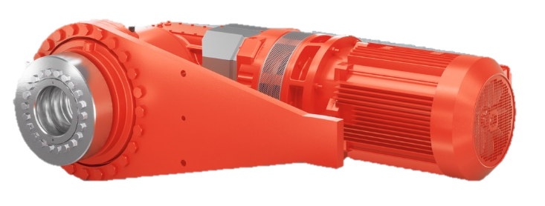
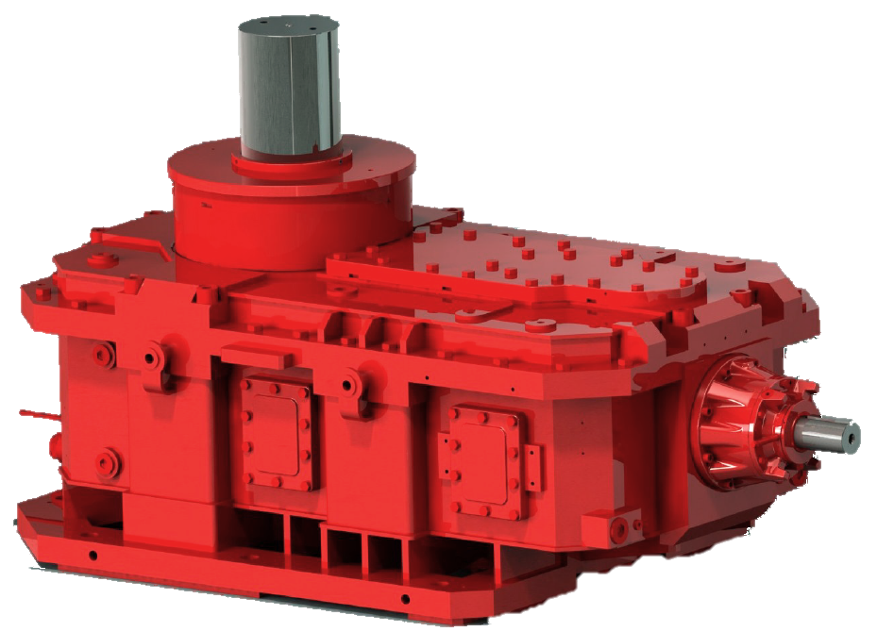
03 – Product Overview
HIG USA Product Overview
XP Series
600-5,200 kNm
22.4-320 ratio
MC Series
8-65 kNm
7.1-112 ratio
X.e Series
6.8-475 kNm
6-390 ratio
P2 Series
24-500 kNm
15-4322 ratio
P-X.e Series
100-500 kNm
157-548 ratio
M1..N Series
1.4-189 kNm
1-7.1 ratio
ML..V..N Series
150-823 kNm
20-315 ratio
Segmented Girth Gear
Up to 7,121 kNm
Up to 52 ft diameter
Assembled in US
Supported in US

Slide 10
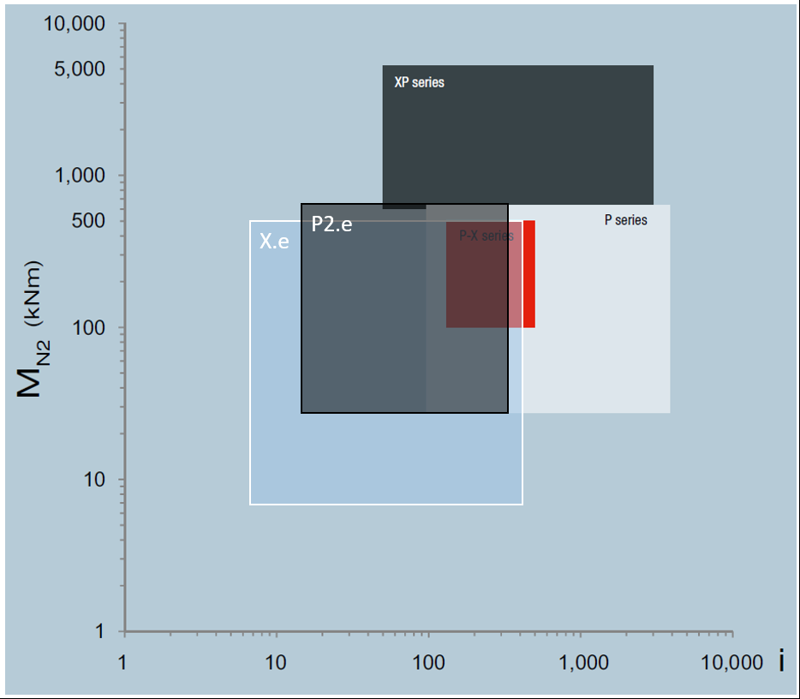
03 – Product Overview
HIG USA Product Overview
P-X Series
MC
M1..N

Slide 11
Agenda
04
Applications
01
What is HIG?
02
SEW HIG USA
03
Product Overview
05
HIG + Automation
06
Custom Designs
07
Our Team
08
Summary

Slide 12
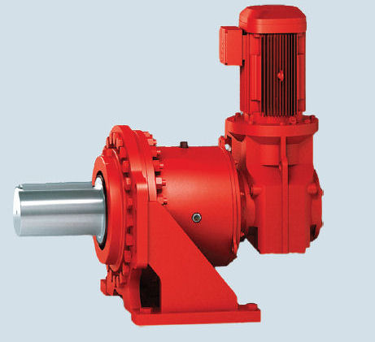
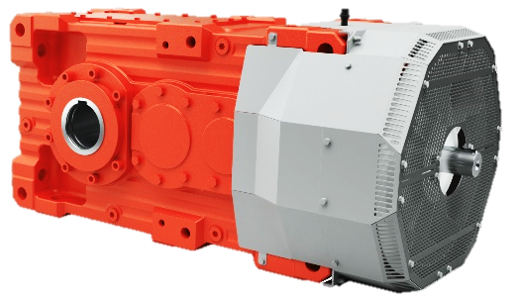
04 – Applications
HIG Applications
NYE Ball Drop
Celebratory orb in Times Square, New York begins a controlled descent to usher in each New Year
P2 Series
Massive mining machines that continuously gather material from Earth’s surface
P2 Series
X.e Series
Largest built:
31,300,000 lbs
Bucket excavators

Slide 13
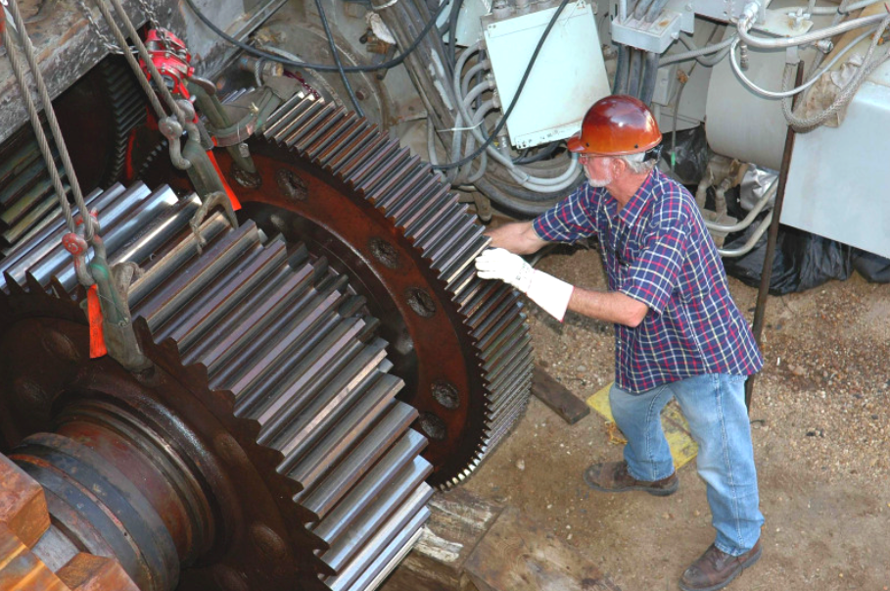
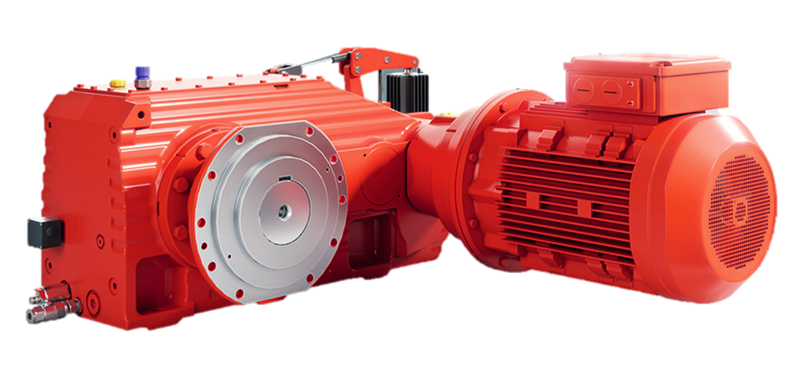
04 – Applications
HIG Applications
NASA Launch Pad
NASA moves their enormous rockets using tracked launch pads (“crawlers”)
Custom gearing
Fuel economy:
165 gal per mile
0.006 mpg
Crane drives in the steel industry must be strong, reliable, and able to withstand hot temperatures
X.e/HC Series
Smelting Hoists

Slide 14
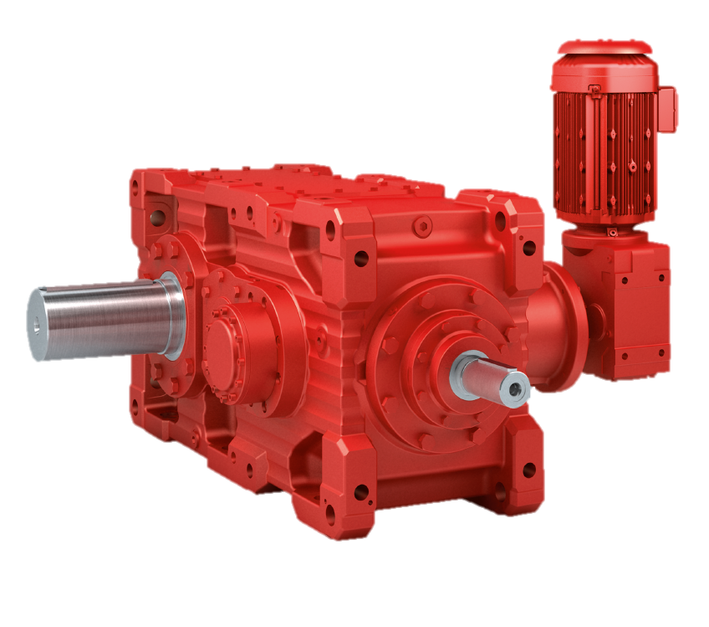
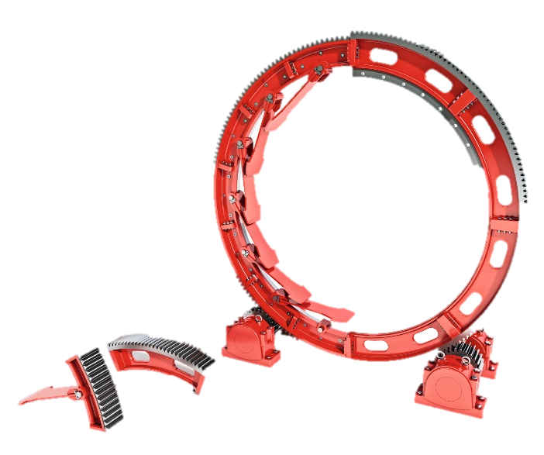
04 – Applications
HIG Applications
Bucket elevators
This “vertical conveyor” commonly moves grain and crushed rock
X.e Bucket Elevator Series
Common design:
Aux. drives and backstops
Ball mills are huge rotating machines that pulverize material (often rock) using golf-ball-sized metal shot
Segmented
Girth
Gear
(SGG)
X.e Series
Ball mills

Slide 15
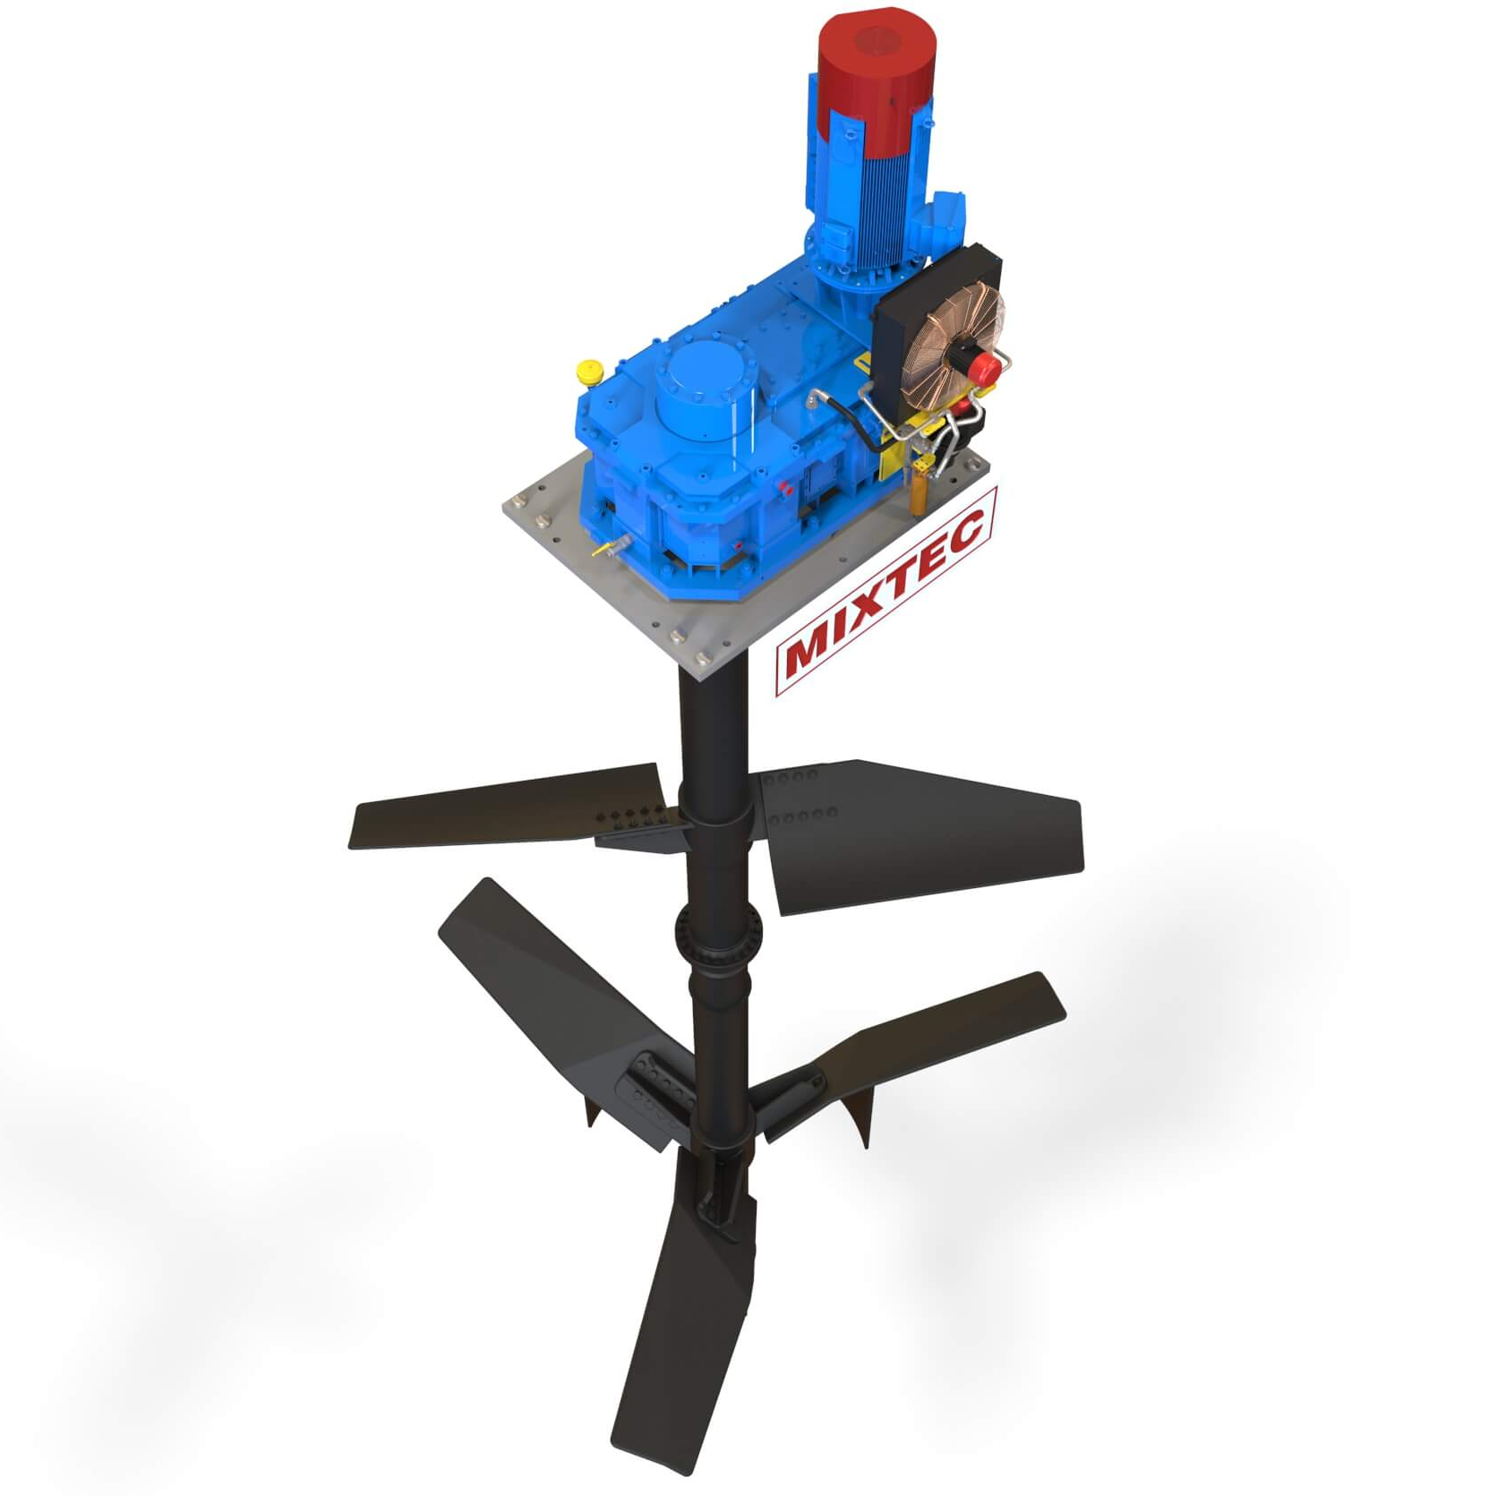
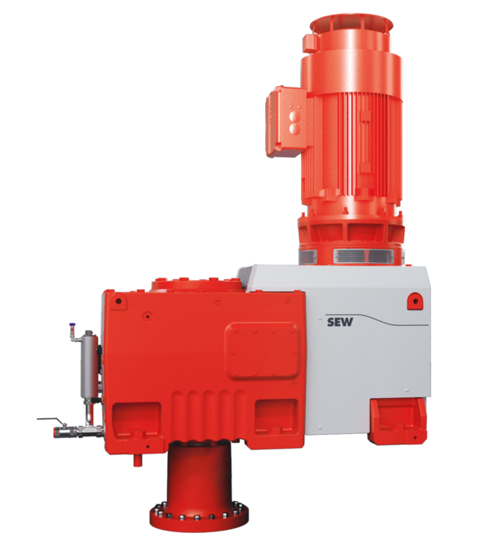
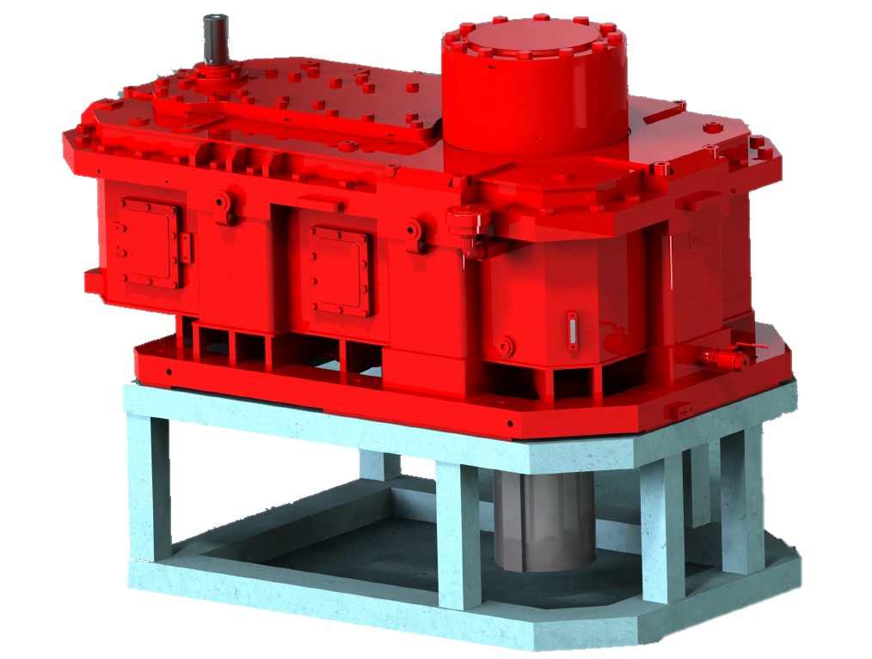
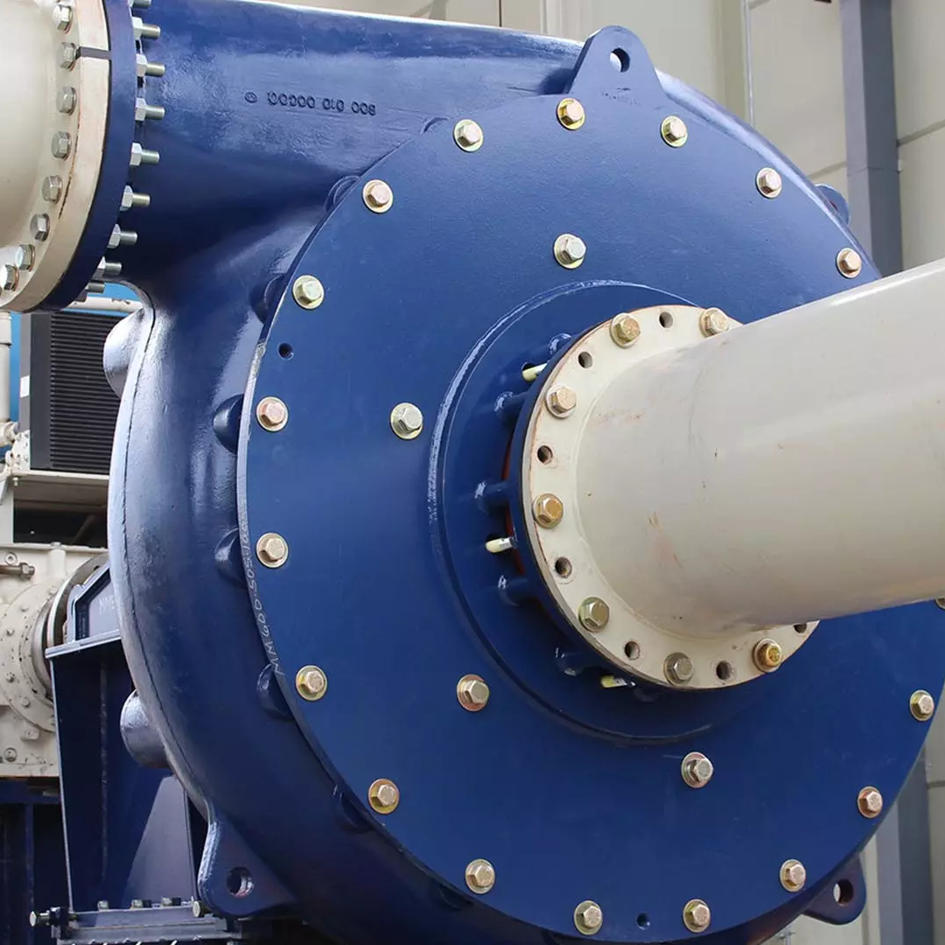
04 – Applications
HIG Applications
Mixers
Many industries use large mixers to combine materials and speed chemical reactions
X.e/HM Agitator
Series
ML..V..N Series
High external forces possible
Pumps are used in nearly every industry to move liquid and semi-liquid material in a controlled way
M1..N Series
Pumps

Slide 16
Agenda
05
HIG + Automation
01
What is HIG?
02
SEW HIG USA
03
Product Overview
04
Applications
06
Custom Designs
07
Our Team
08
Summary

Slide 17
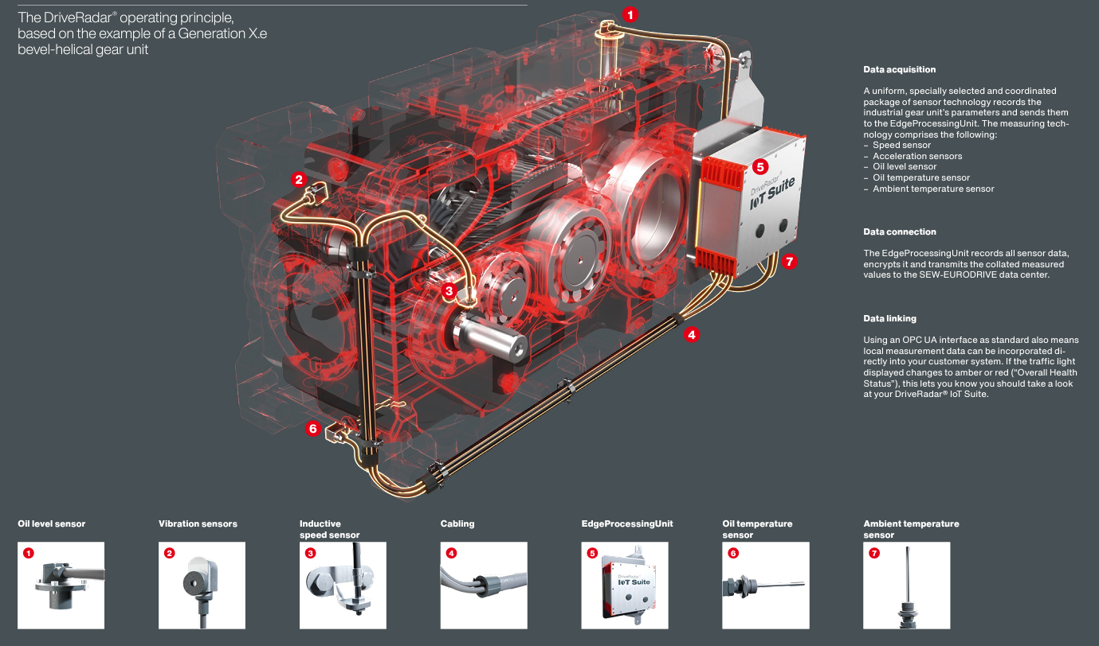
05 – HIG + Automation
HIG DriveRadar®
Oil level sensor
Condition monitoring and
maintenance forecasts
for new and existing
gear units
Edge Processing Unit
Vibration sensor
Ambient temp. sensor
Oil temperature sensor
Cabling
Inductive speed sensor

Slide 18
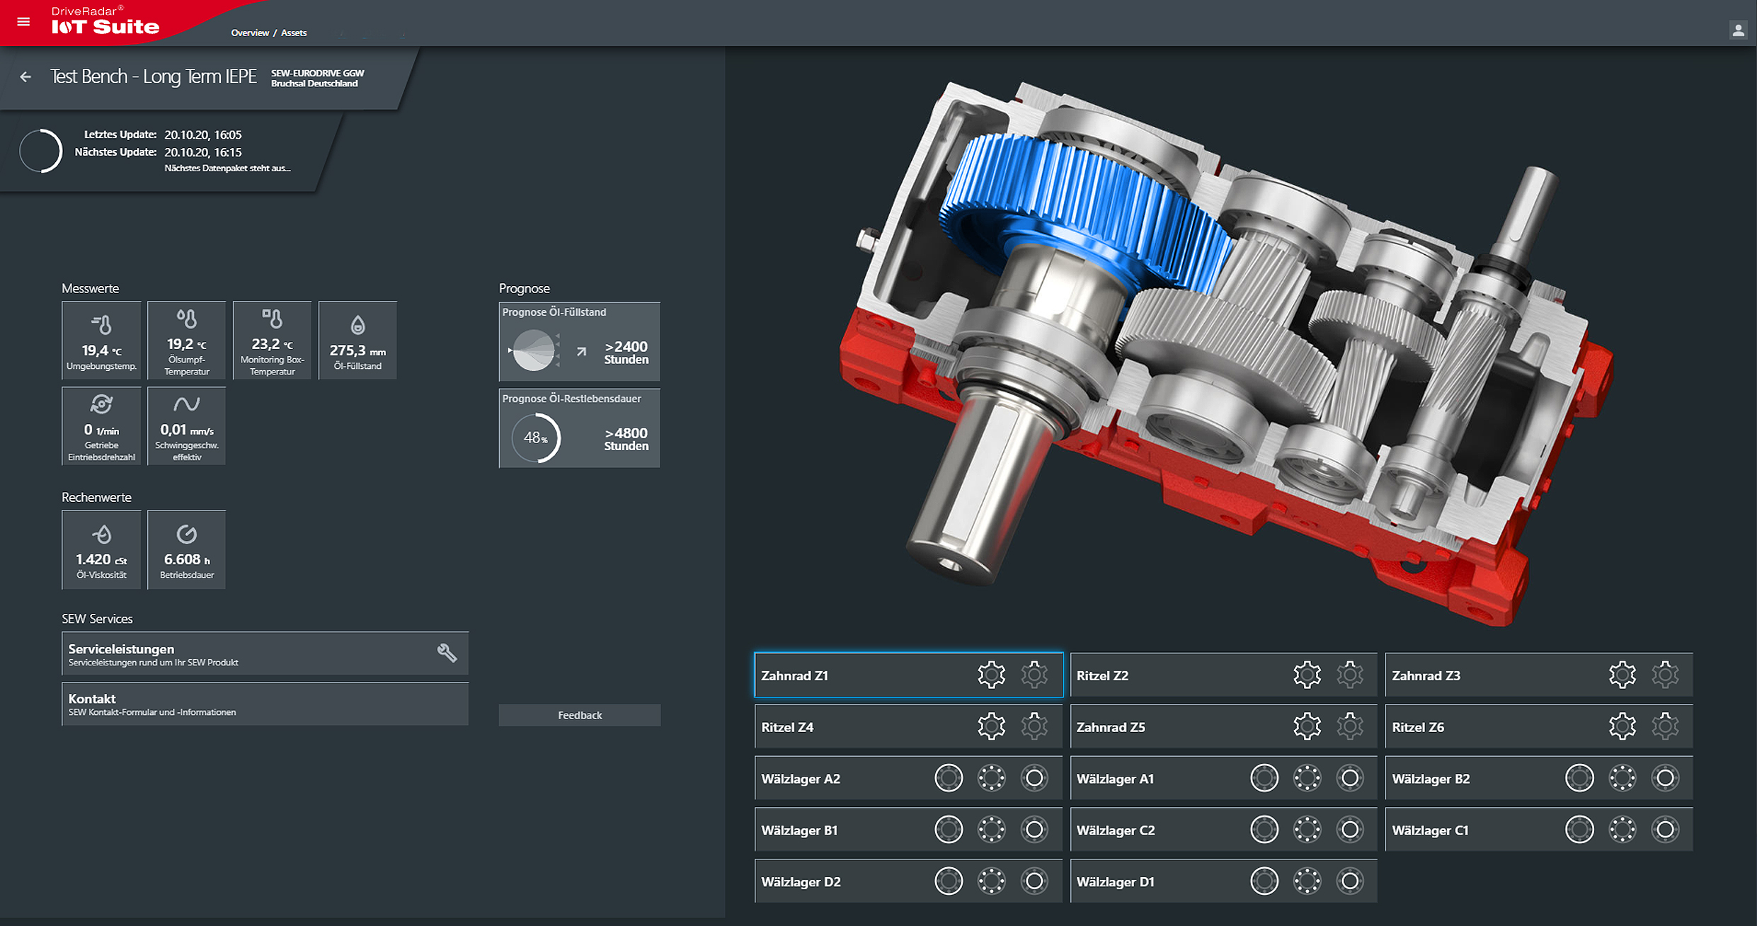
05 – HIG + Automation
Results:
Oil level forecast:
Ambient temp.
Gearbox temp.
Electronics temp.
Oil level
hours
Oil life forecast:
Input speed
Vibration response
hours
Calculations:
Oil viscosity
Vibration response
Service Center List
Gear Z1
Pinion Z2
Gear Z3
Contacts
Pinion Z4
Gear Z5
Pinion Z6
Bearing A2
Bearing A1
Bearing B2
Bearing B1
Bearing C2
Bearing C1
stay connected.
Bearing D2
Bearing D1

Slide 19
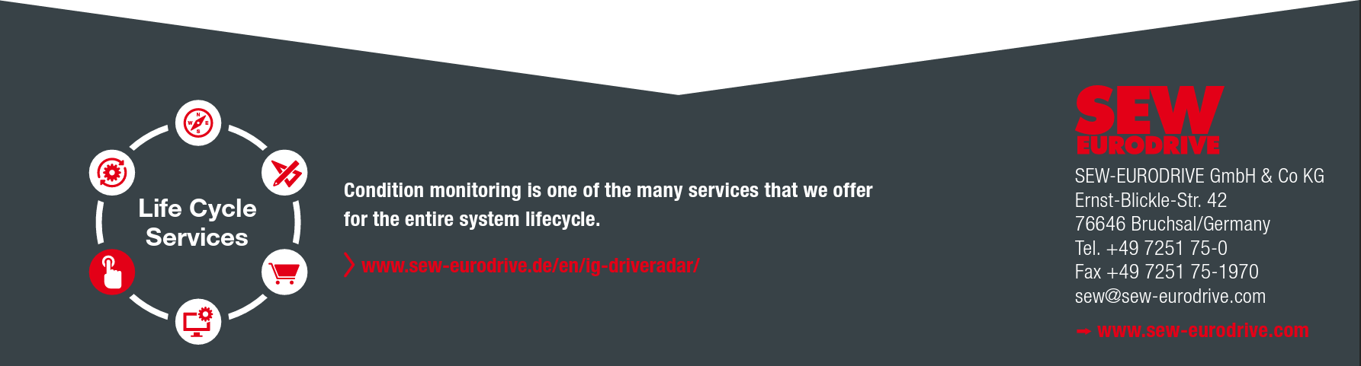
05 – HIG + Automation
HIG DriveRadar®
Condition monitoring and
maintenance forecasts
for new and existing
gear units
Avoid downtime – Sensor data → Edge Processing Unit → Secure Cloud Server → SEW DriveRadar® IoT Suite → Asset Forecasting + Alerts (mobile & desktop)
Decrease maintenance costs – catch failures before they strike
Know your drive – pinpoint at-risk components and eliminate guess-work
https://www.sew-eurodrive.de/en/ig-driveradar/

Slide 20
Agenda
01
What is HIG?
02
SEW HIG USA
03
Product Overview
04
Applications
05
HIG + Automation
06
Custom Designs
07
Our Team
08
Summary

Slide 21
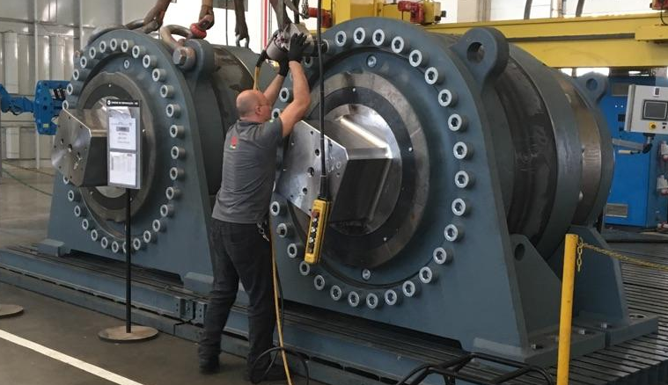
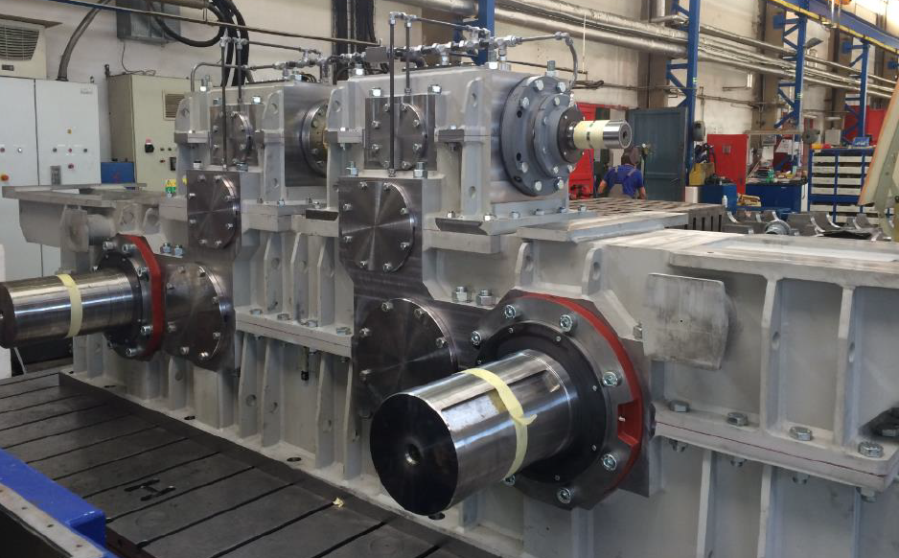
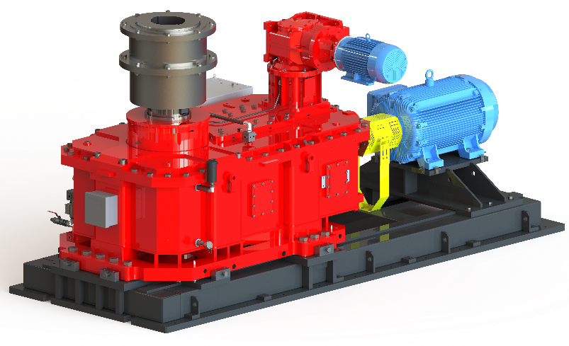
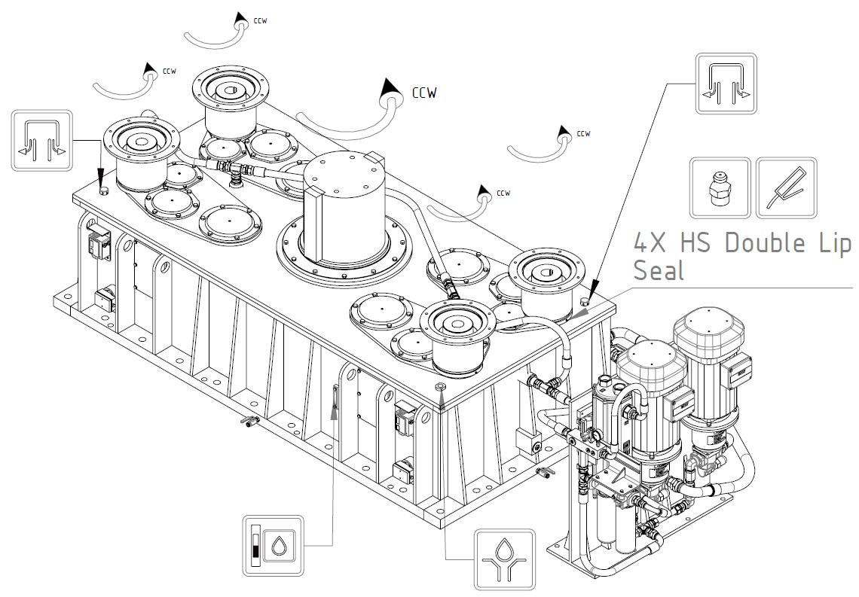
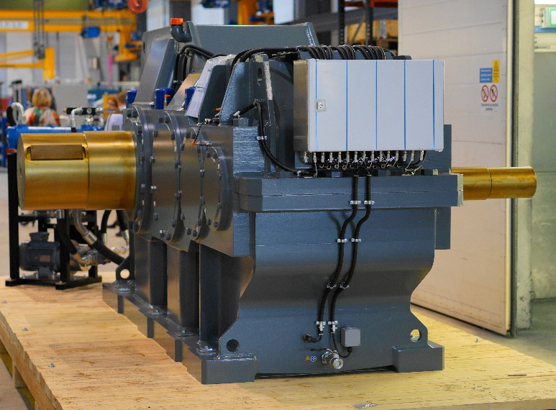
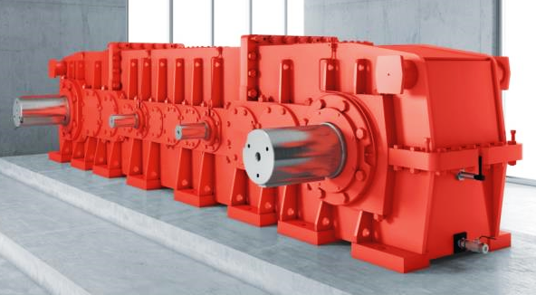
06 – Custom Designs
Custom is our standard!
SEW has multiple HIG manufacturing plants around the world
Oilseed extraction
Hoist drive with mechanical synchronization
Sugar processing
Oxygen reactor
Conveyor
Steel rolling

Slide 22
Agenda
01
What is HIG?
02
SEW HIG USA
03
Product Overview
04
Applications
05
HIG + Automation
07
Our Team
06
Custom Designs
08
Summary

Slide 23
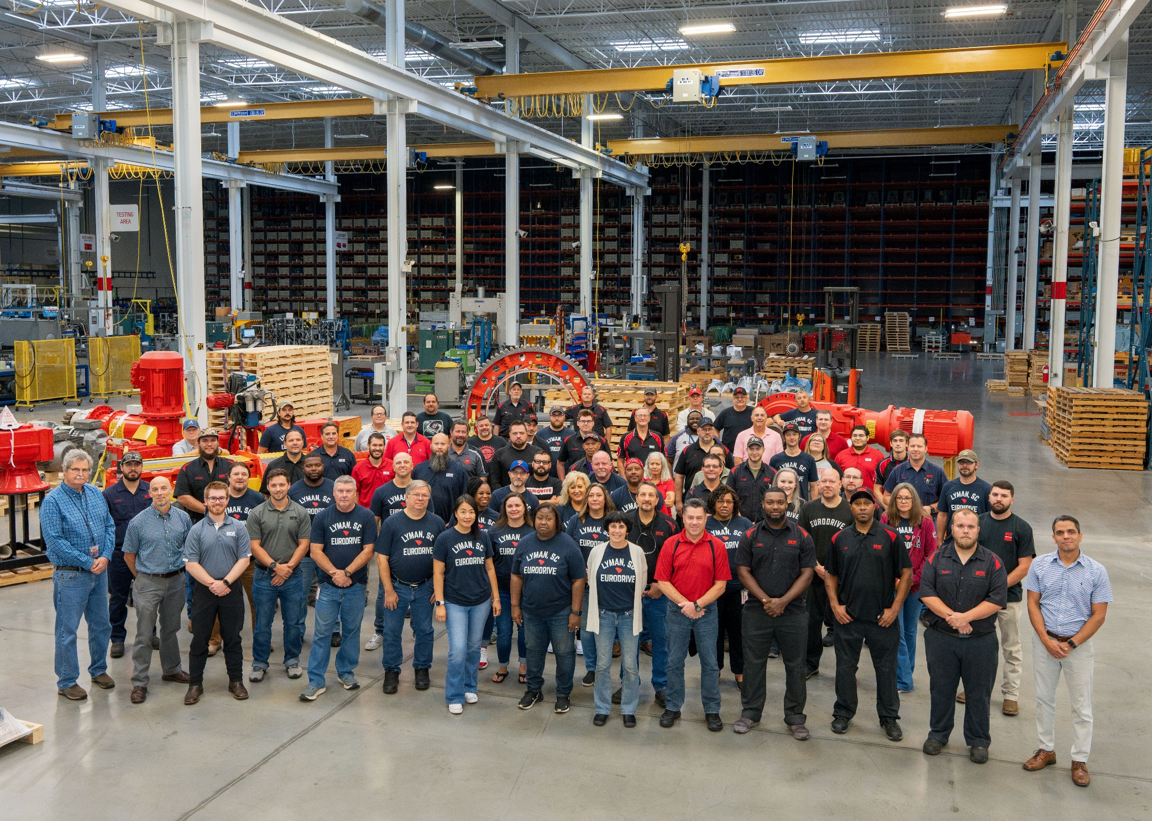
07 – Our Team
Real people. Real solutions.

Slide 24





































































07 – Our Team
Here to help!

Slide 25
Agenda
01
What is HIG?
02
SEW HIG USA
03
Product Overview
04
Applications
05
HIG + Automation
08
Summary
06
Custom Designs
07
Our Team

Slide 26


08 – Summary
Big Picture
SEW has you covered – whether your needs are bIG or small, we have the products, knowledge, and drive to help you succeed!
SEW drives the world – our global network provides world-class products, while our local focus keeps support human

Slide 27

Thank you for your time!

